Slide 1
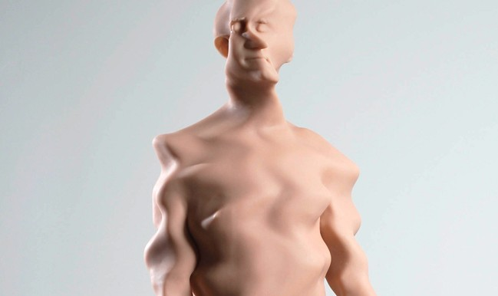
3d Imaging and Fabrication
for the Art Classroom

Slide 2
3d Printing Basics
3d Printing is an additive manufacturing process, that extrudes material in layers. Geometry is not limited by traditional production and manufacturing processes due to support material. Some printers support 2 or more colors. Some printers work with dissolvable support material.
3d printing is currently being used in large and small scale applications: engineering and robotics, architecture, industrial design, fashion design, space exploration, aeronautics, transportation design, visual arts, theater and cinema arts, and culinary applications. 3D printing is also being used in medical and scientific innovation such as; prosthetics, and printing with living tissue to create skin and other organs.
A 3d print requires closed or ‘water tight’ three dimensional models. Original three dimensional models can be created in 3d modeling programs such as Rhino or Blender, Inventor, Solid Works, Google Sketch-Up and others. There are many free user friendly 3d modeling programs such as Sculptriss and Autodesk n123D Design.
The MakerBot Replicator 2 uses PLA (Polylactic Acid), which is bio-plastic derived from corn and is biodegradable. It is available in several textures, and colors. ABS (Acrylonitrile Butadiene Styrene) is another common type of polymer filament used in desktop 3d printers. ABS can be used with dissolvable support material.

Slide 3
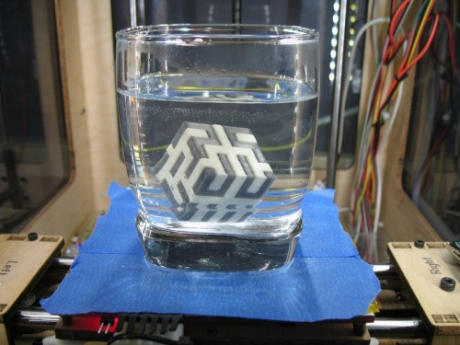
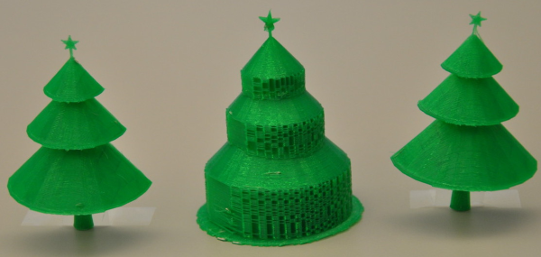
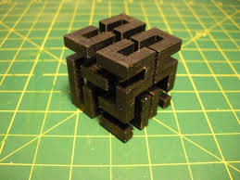
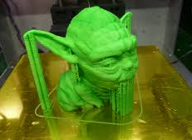
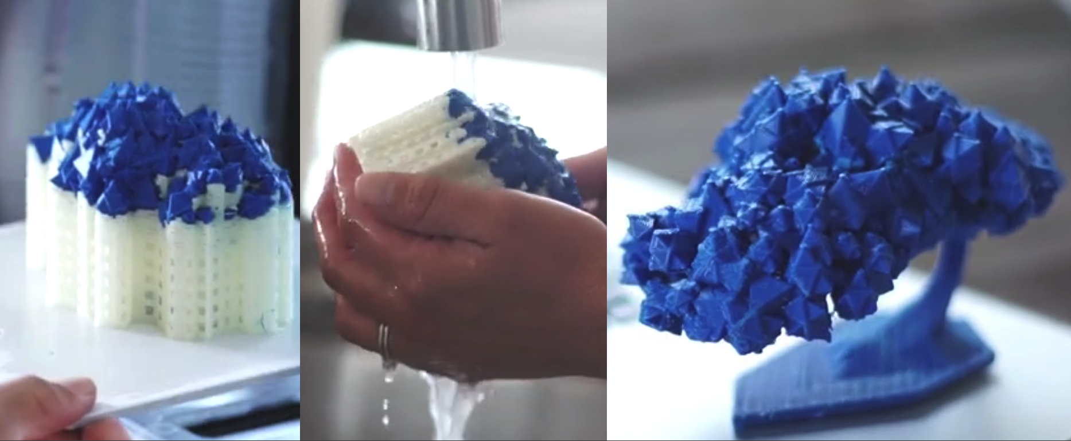
Support Material
Dissolvable

Slide 4
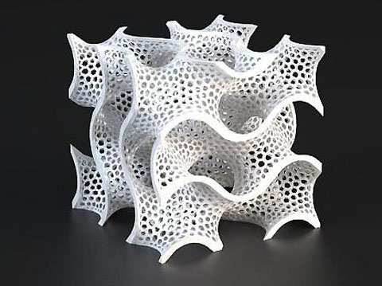
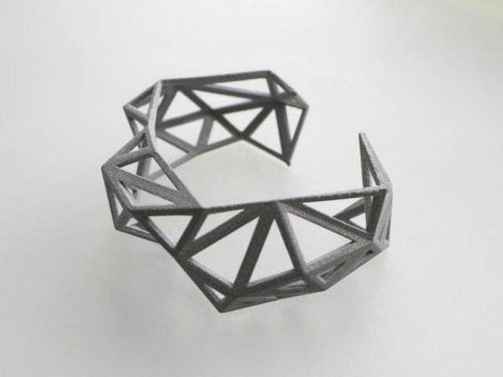
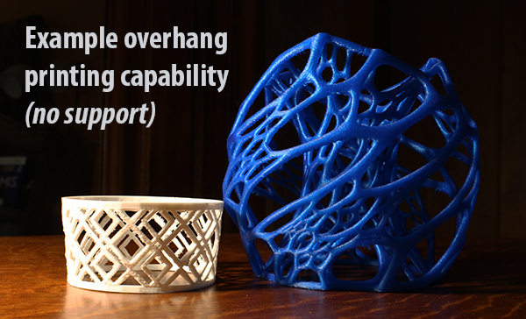
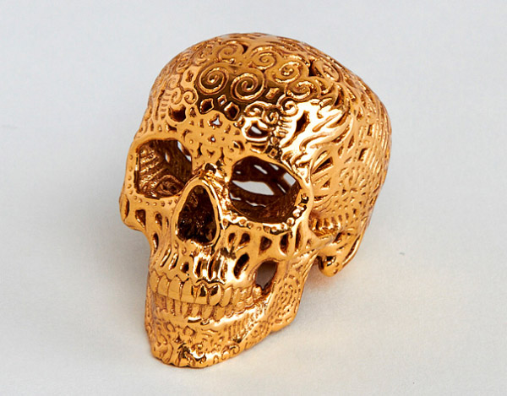

Slide 5
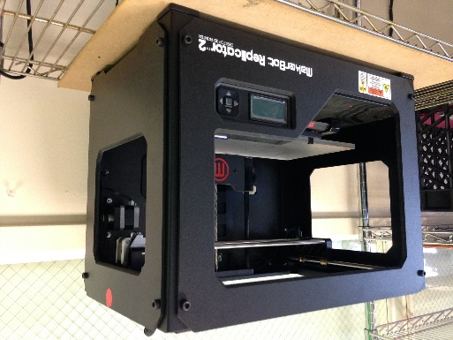
Desktop 3D Printers
MakerBot Home page
MakerBot Review
Replicator on MakerBot Site
http://store.makerbot.com/filament
Stratasys
Formlabs
3dSystems
CUBIFY
The Cube
3d Print.com
List of Desktop printers

Slide 6
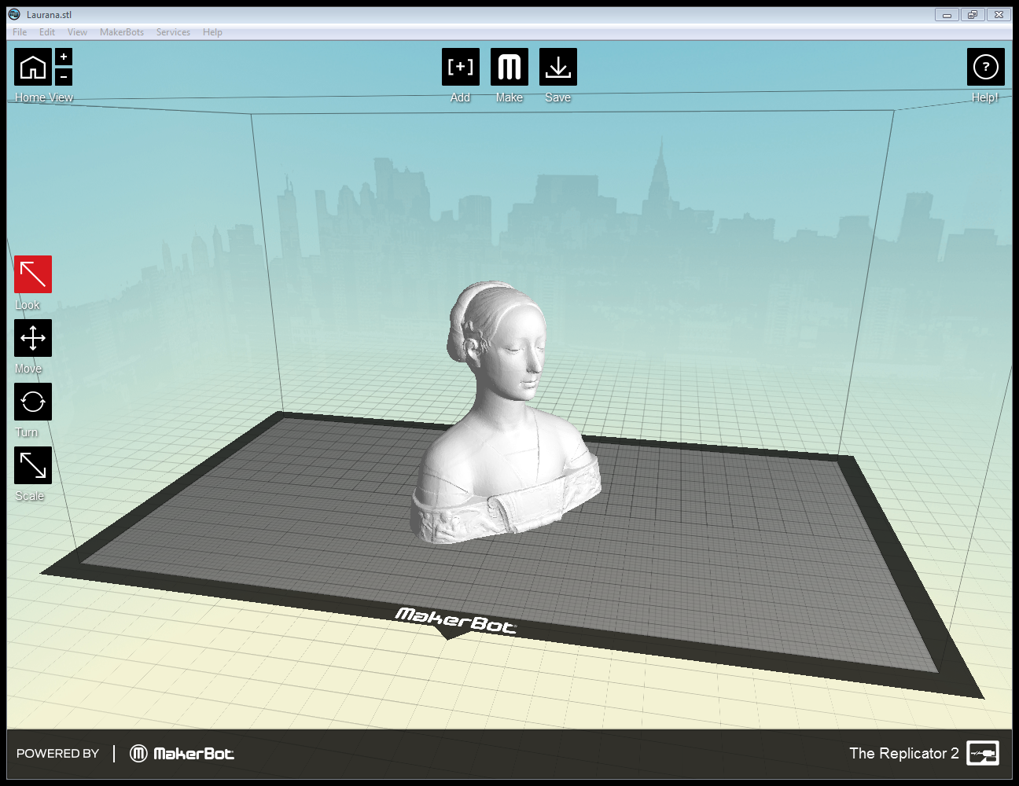
Making a Print
Three-dimensional models are exported as .STL (StereoLithographic) files which are then prepared for printing using ‘G-code’. The example below is Makerbot’s ‘Makerware’, where STL files sliced and settings are chosen for structural details, layer thickness, and support material. Most 3d printers will come with their own G-code interface design.

Slide 8
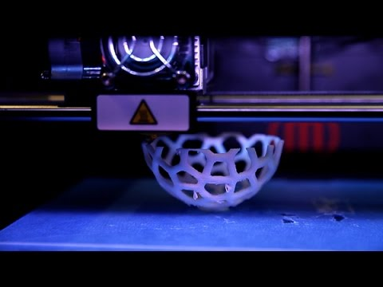
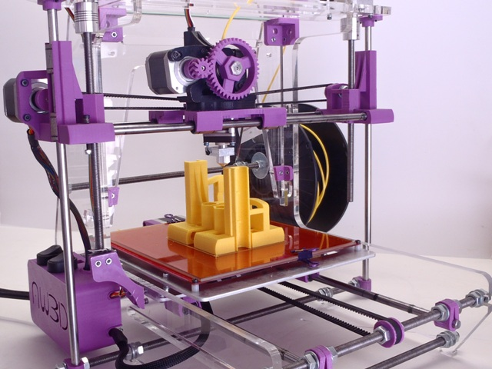
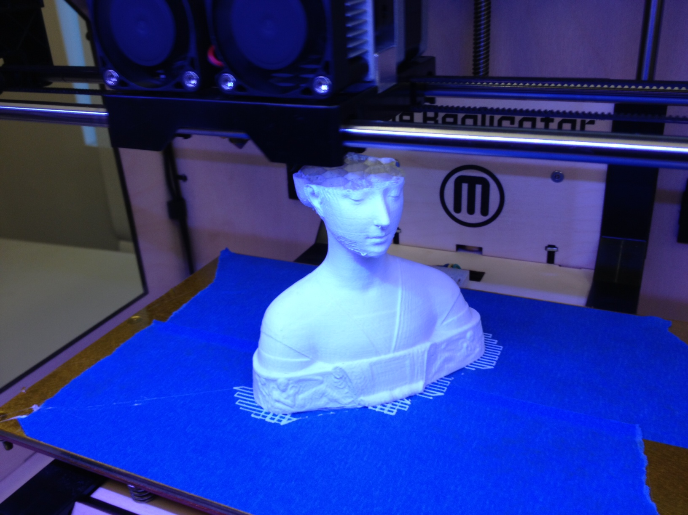
Typical SLA Extrusion type (Makerbot)
Or build your own….

Slide 9
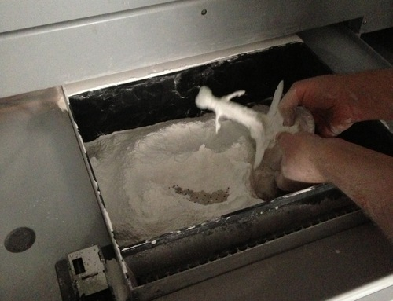
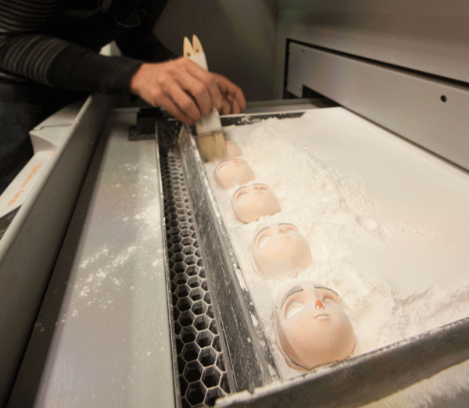
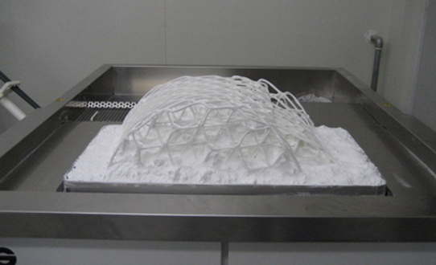
FDM, DLP…

Slide 10
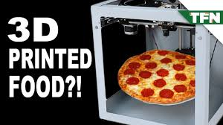
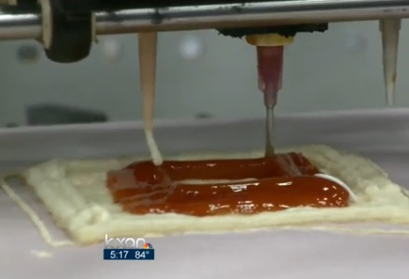
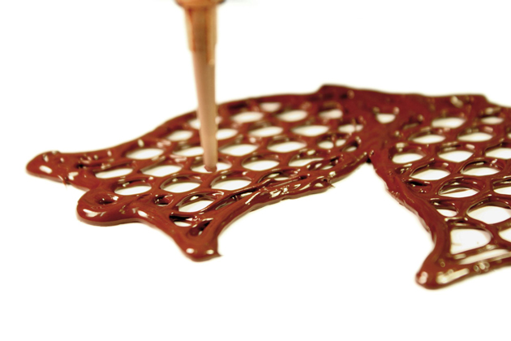
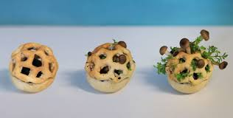
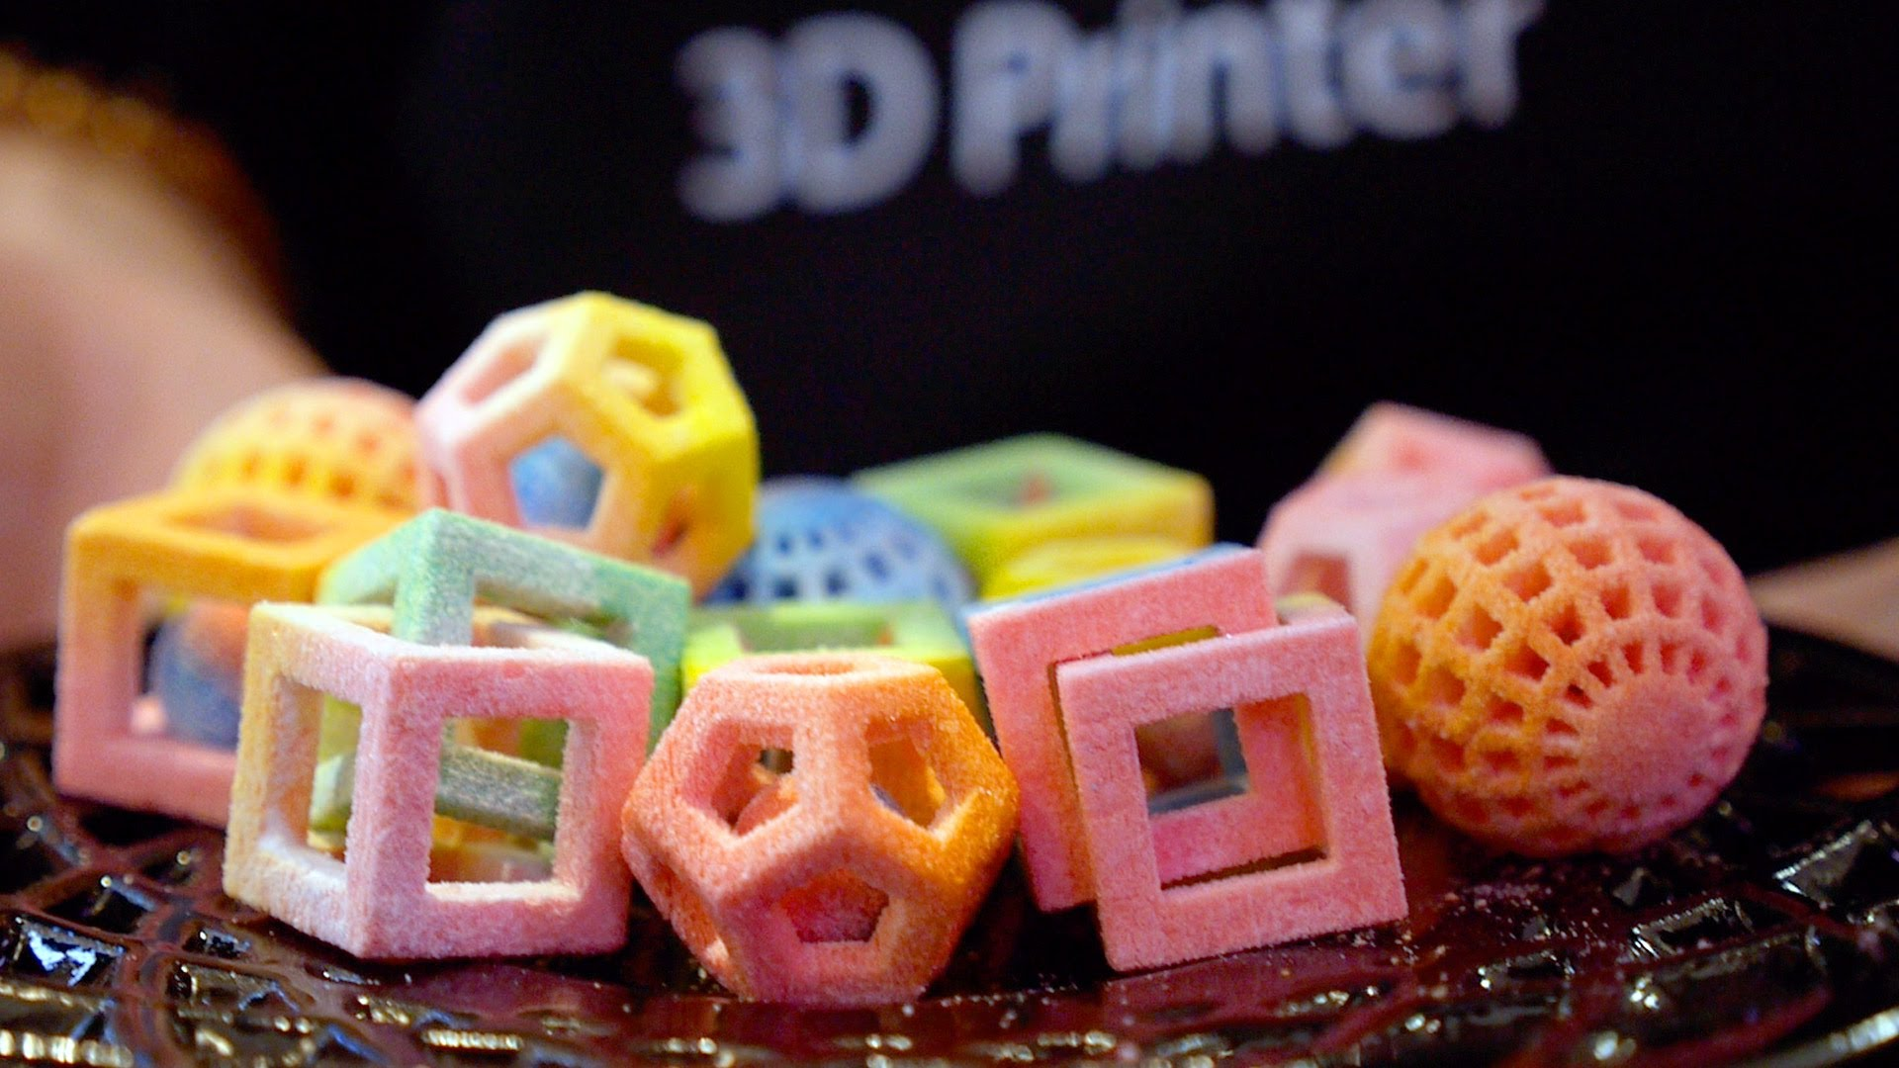
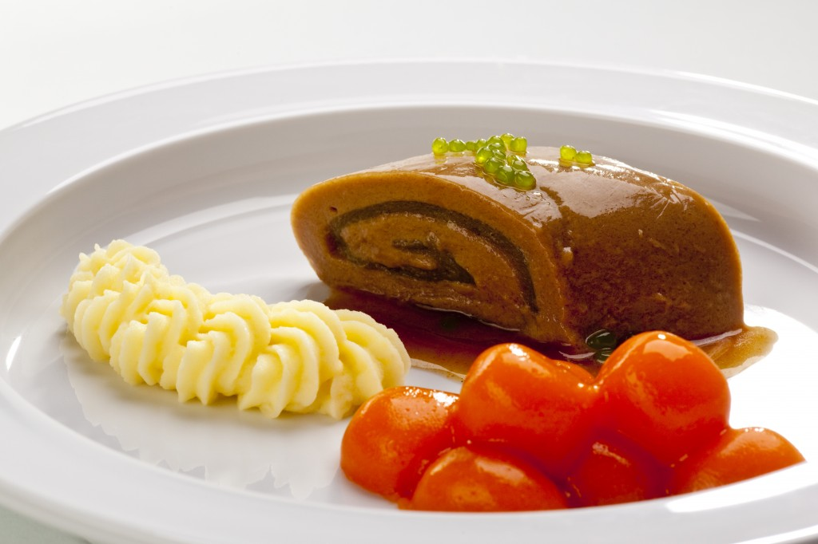

Slide 11
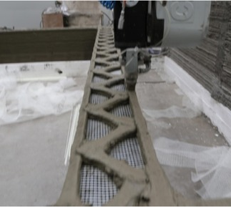
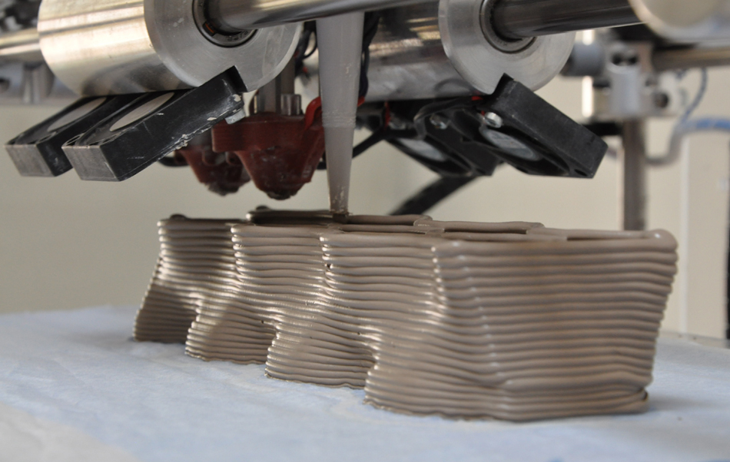
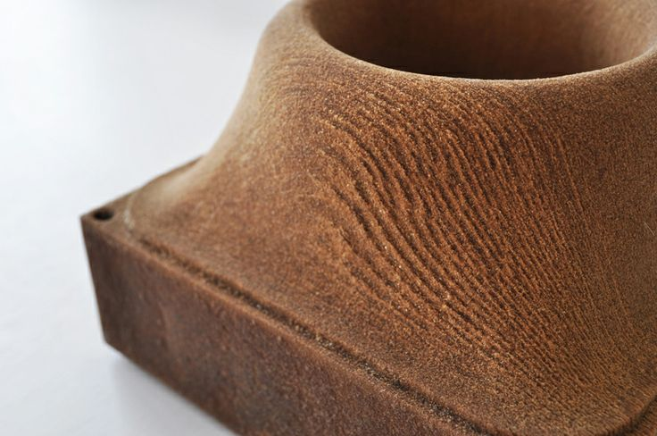
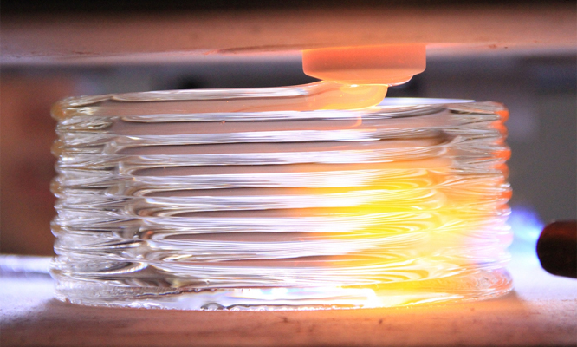
Clay/ Porcelain /Plaster
Concrete
Wood
Metals
Glass

Slide 12
In the Classroom
Students are able to design and print original pieces of art and design. Projects can vary across disciplines.
Product design, novelty items, toys, jewelry design, figurines, fashion design, sculptural design, decorative objects, furniture, tools, inventions, replicas, visual aids for the classroom, and more.
A list of ideas by students

Slide 13
Introducing 3d printing to students with Videos
PBS OFF BOOK
Mashable: Everything you need to know…
Amazing Items
Derby's Story
3d Printed hand
Project Daniel
Enabling the Future
Continuum Fashion Co
Crazy Crackers
Crazy guys eat 3d printed pizza
Printing Clothes at Home
Great Blog: What is 3d Printing?
Huff Post: 14 Ways 3d Printing has changed the Art World

Slide 14
On-line Resources for 3d Models
There are plenty of 3d models available for download, and companies to send your models to for printing!
Thingiverse
Shapeways
Shapeways “Art”
3d Educational Resources on Makerbot- Links to Thingiverse Challenges
CUBIFY
Materialise
Stratasys
Stratasys Extreme Redesign
3d Systems
GrabCad

Slide 15
Free 3d Modeling Software
123d Design
Intro to Modifiers
Intro to 123D from Autodesk
Pixelogic: Sculptriss
Intro to Sculptriss
Other Sculptriss Links
TinkerCad
Makerbot Customizer
Nervous System
Blender-Very Advanced 3d Software
Google Sketch up

Slide 16
Other 3d Modeling Software
Rhino 3d
RhinoTV (tutorials)
AutoDesk Inventor
Autodesk 3D Studio max
Maya
Zbrush
SENSE- 3d Scanner- available at MHTC

Slide 17
Other Resources
3d Printing Systems Education Page
Makerbot Academy
SUNY New Paltz offers a two semester curriculum for Digital Imaging and Fabrication. http://www.newpaltz.edu/ddf/index.php
In the near future, SUNY will house the expanded Hudson Valley Advanced Manufacturing Center. http://www.newpaltz.edu/hvamc/
3d Printing Industry E-zine
Interesting Vid: Future of Design (no mouse)

Slide 18
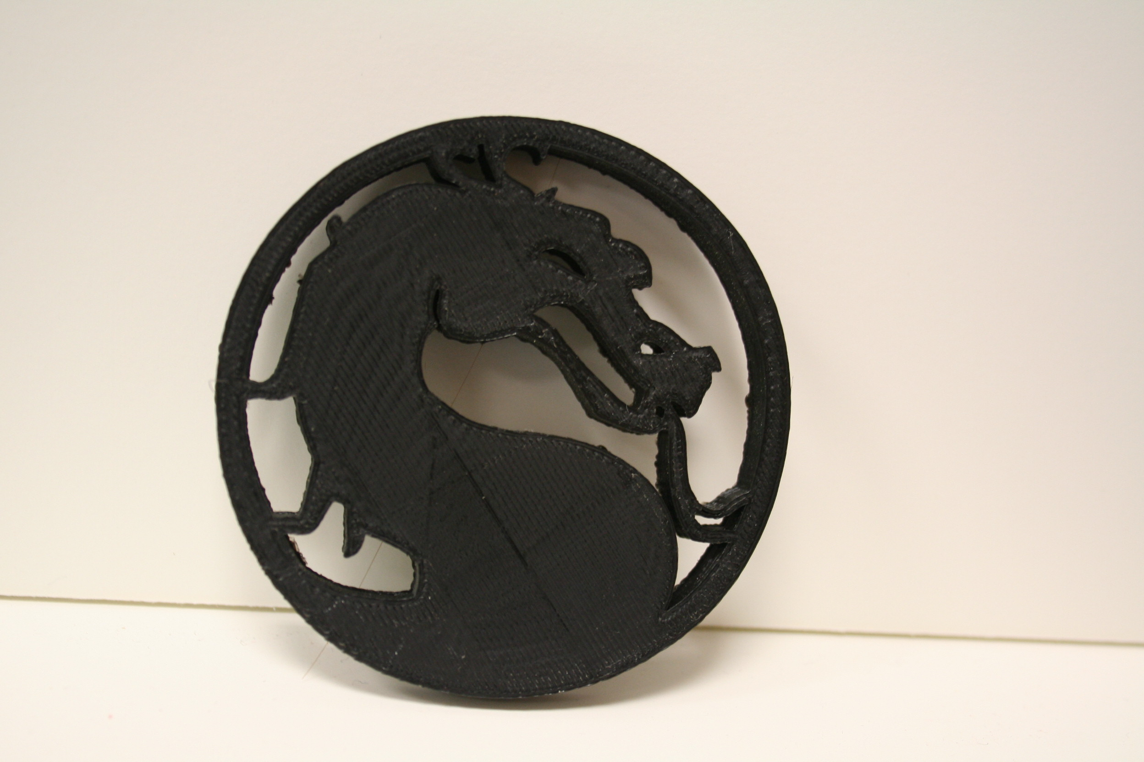
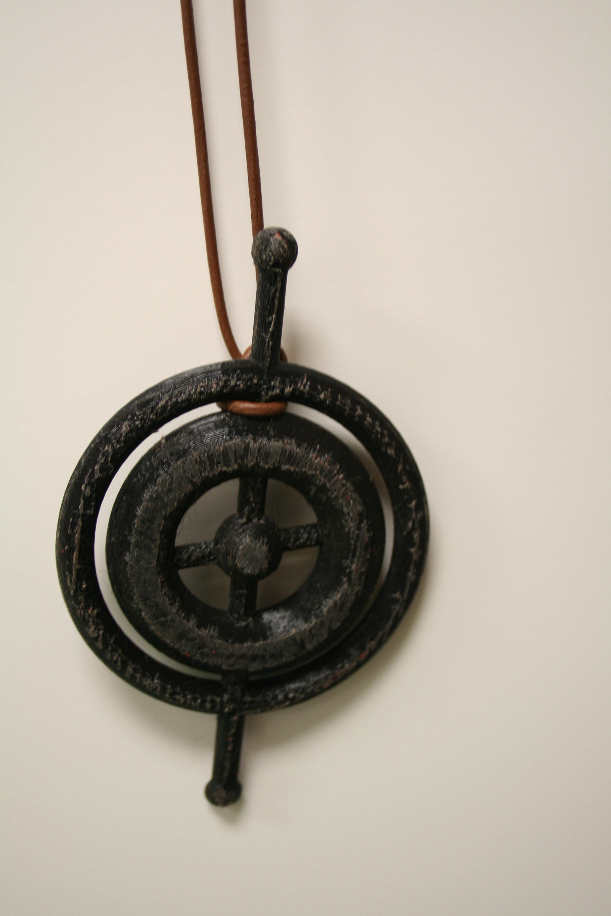
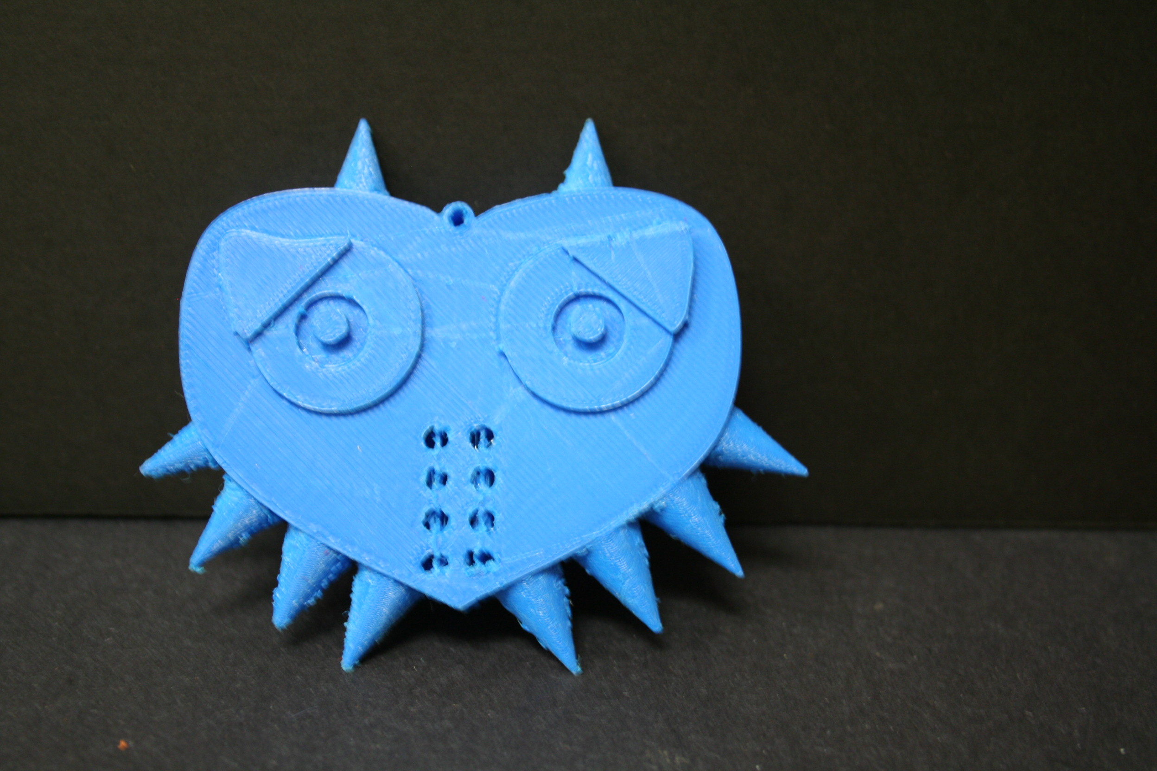
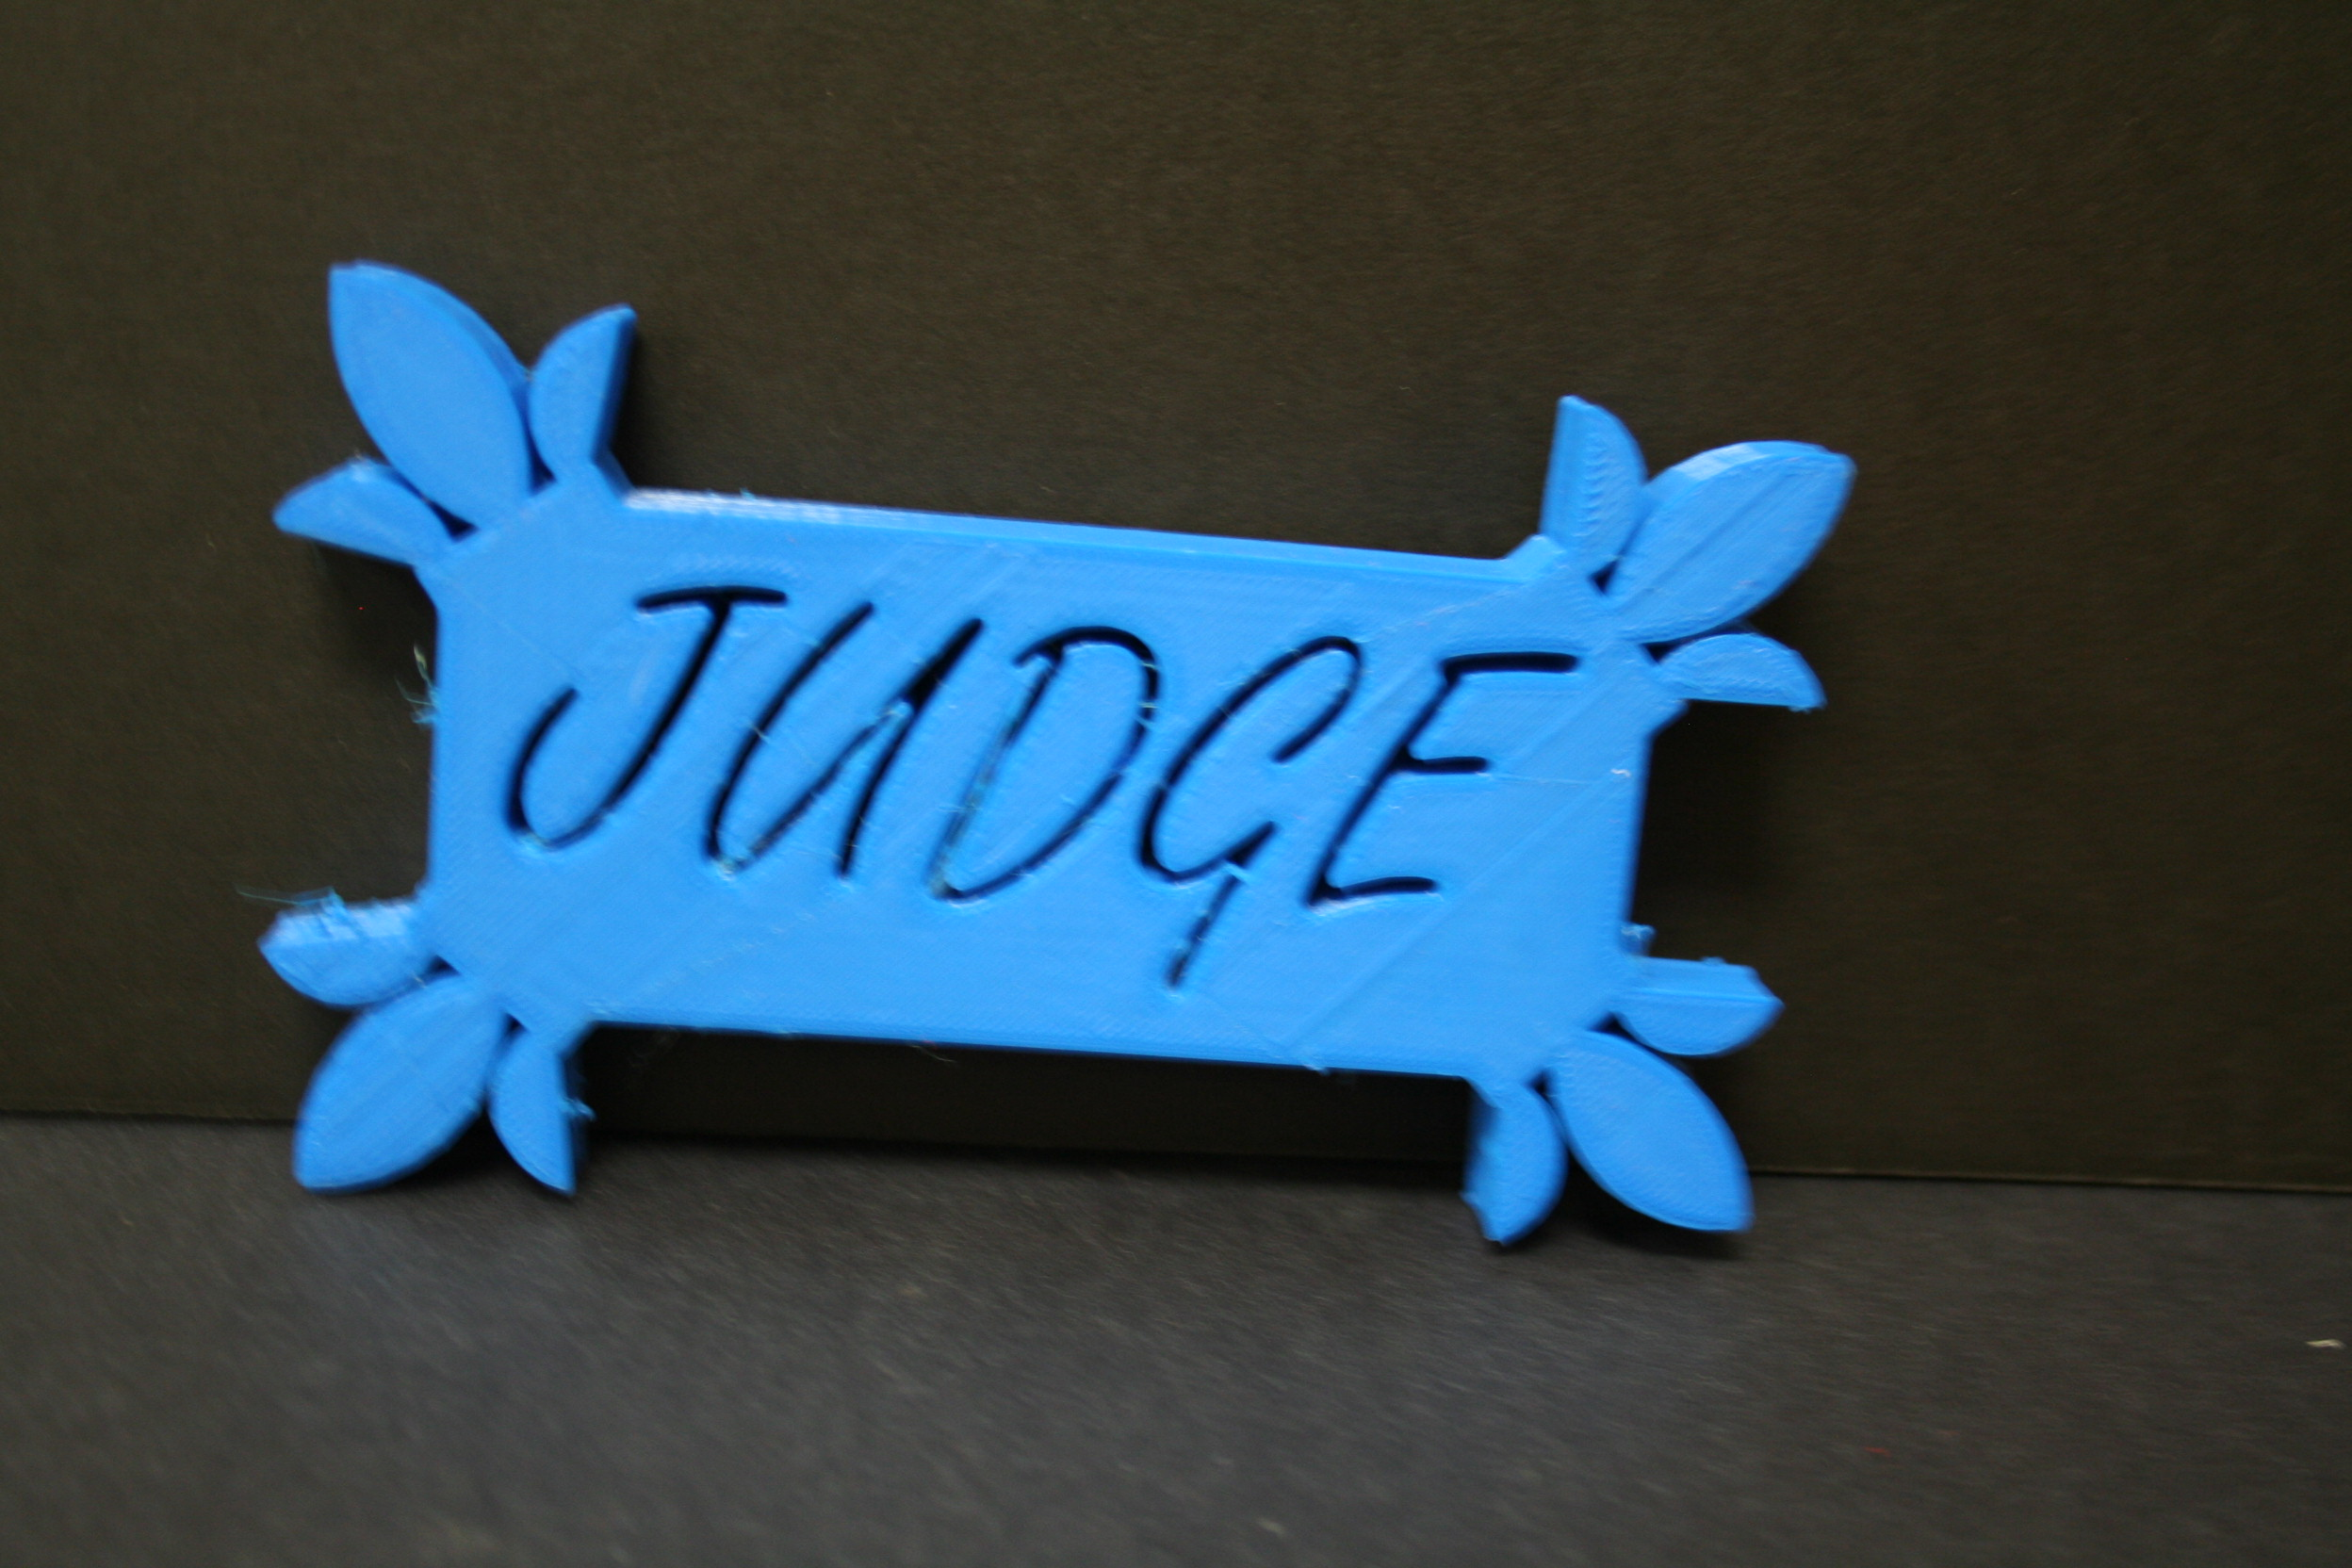

Slide 19
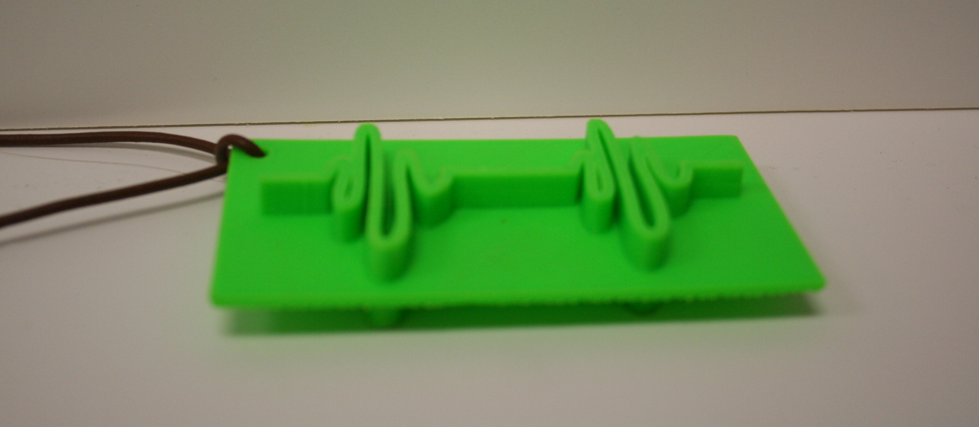
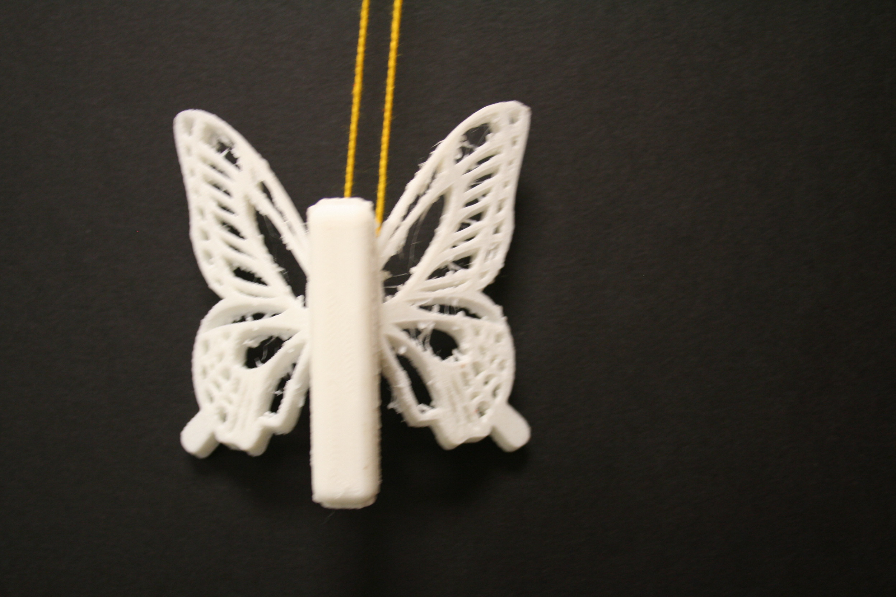
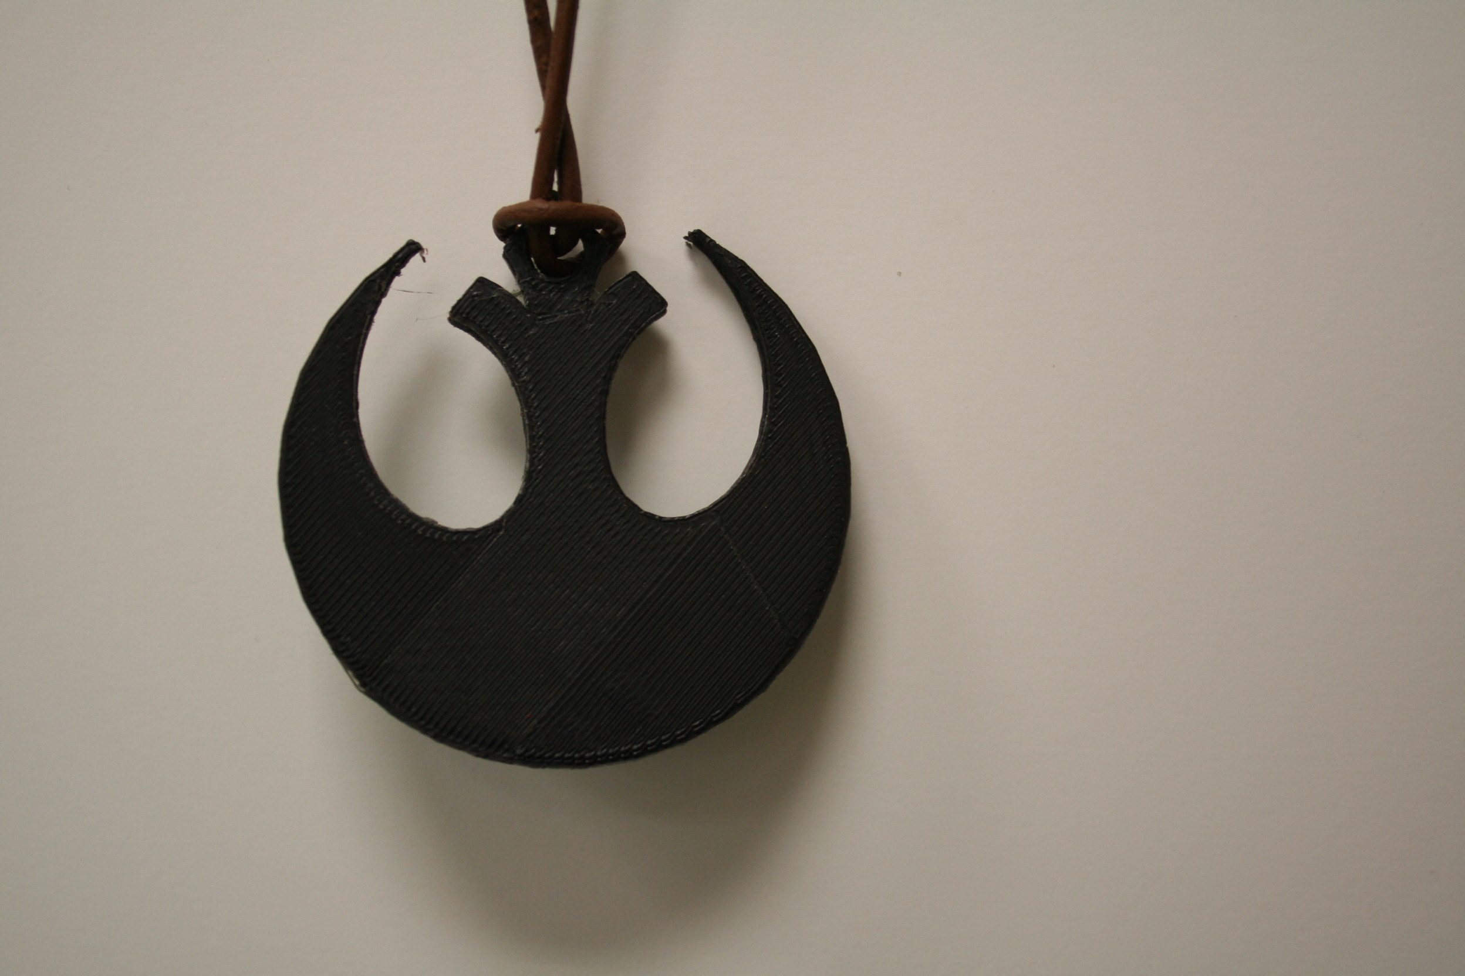

Slide 20
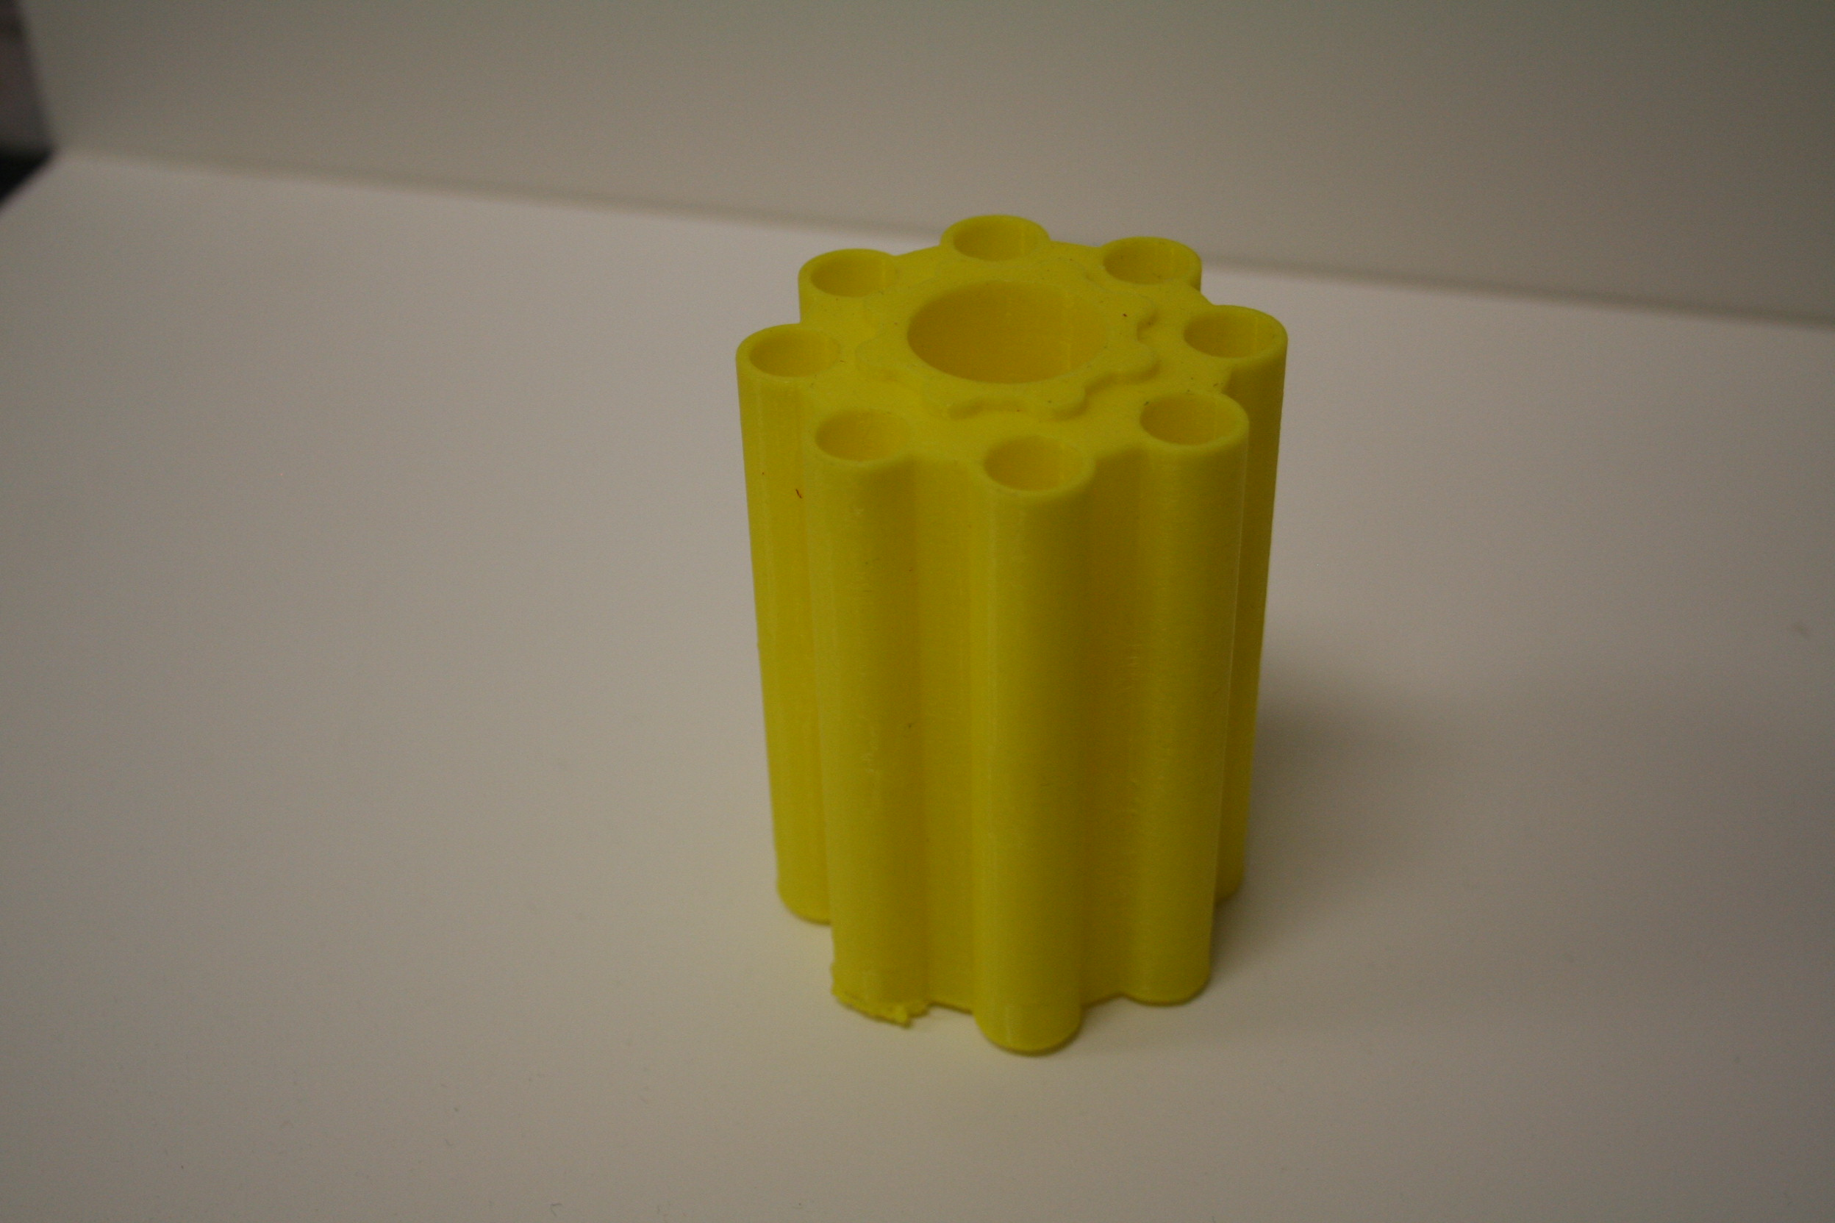
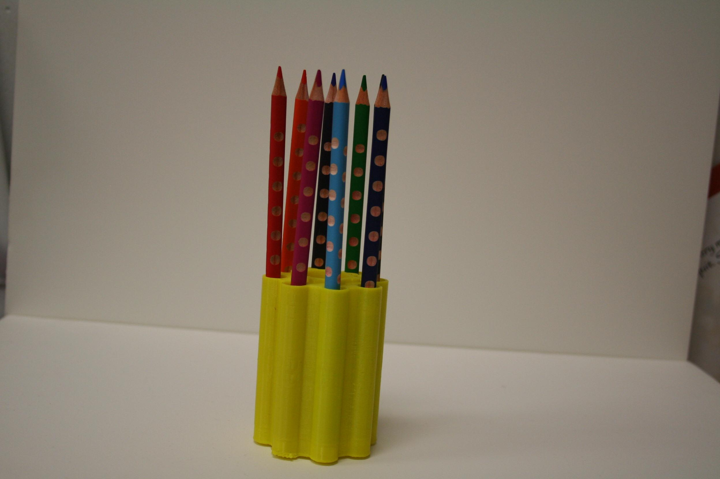
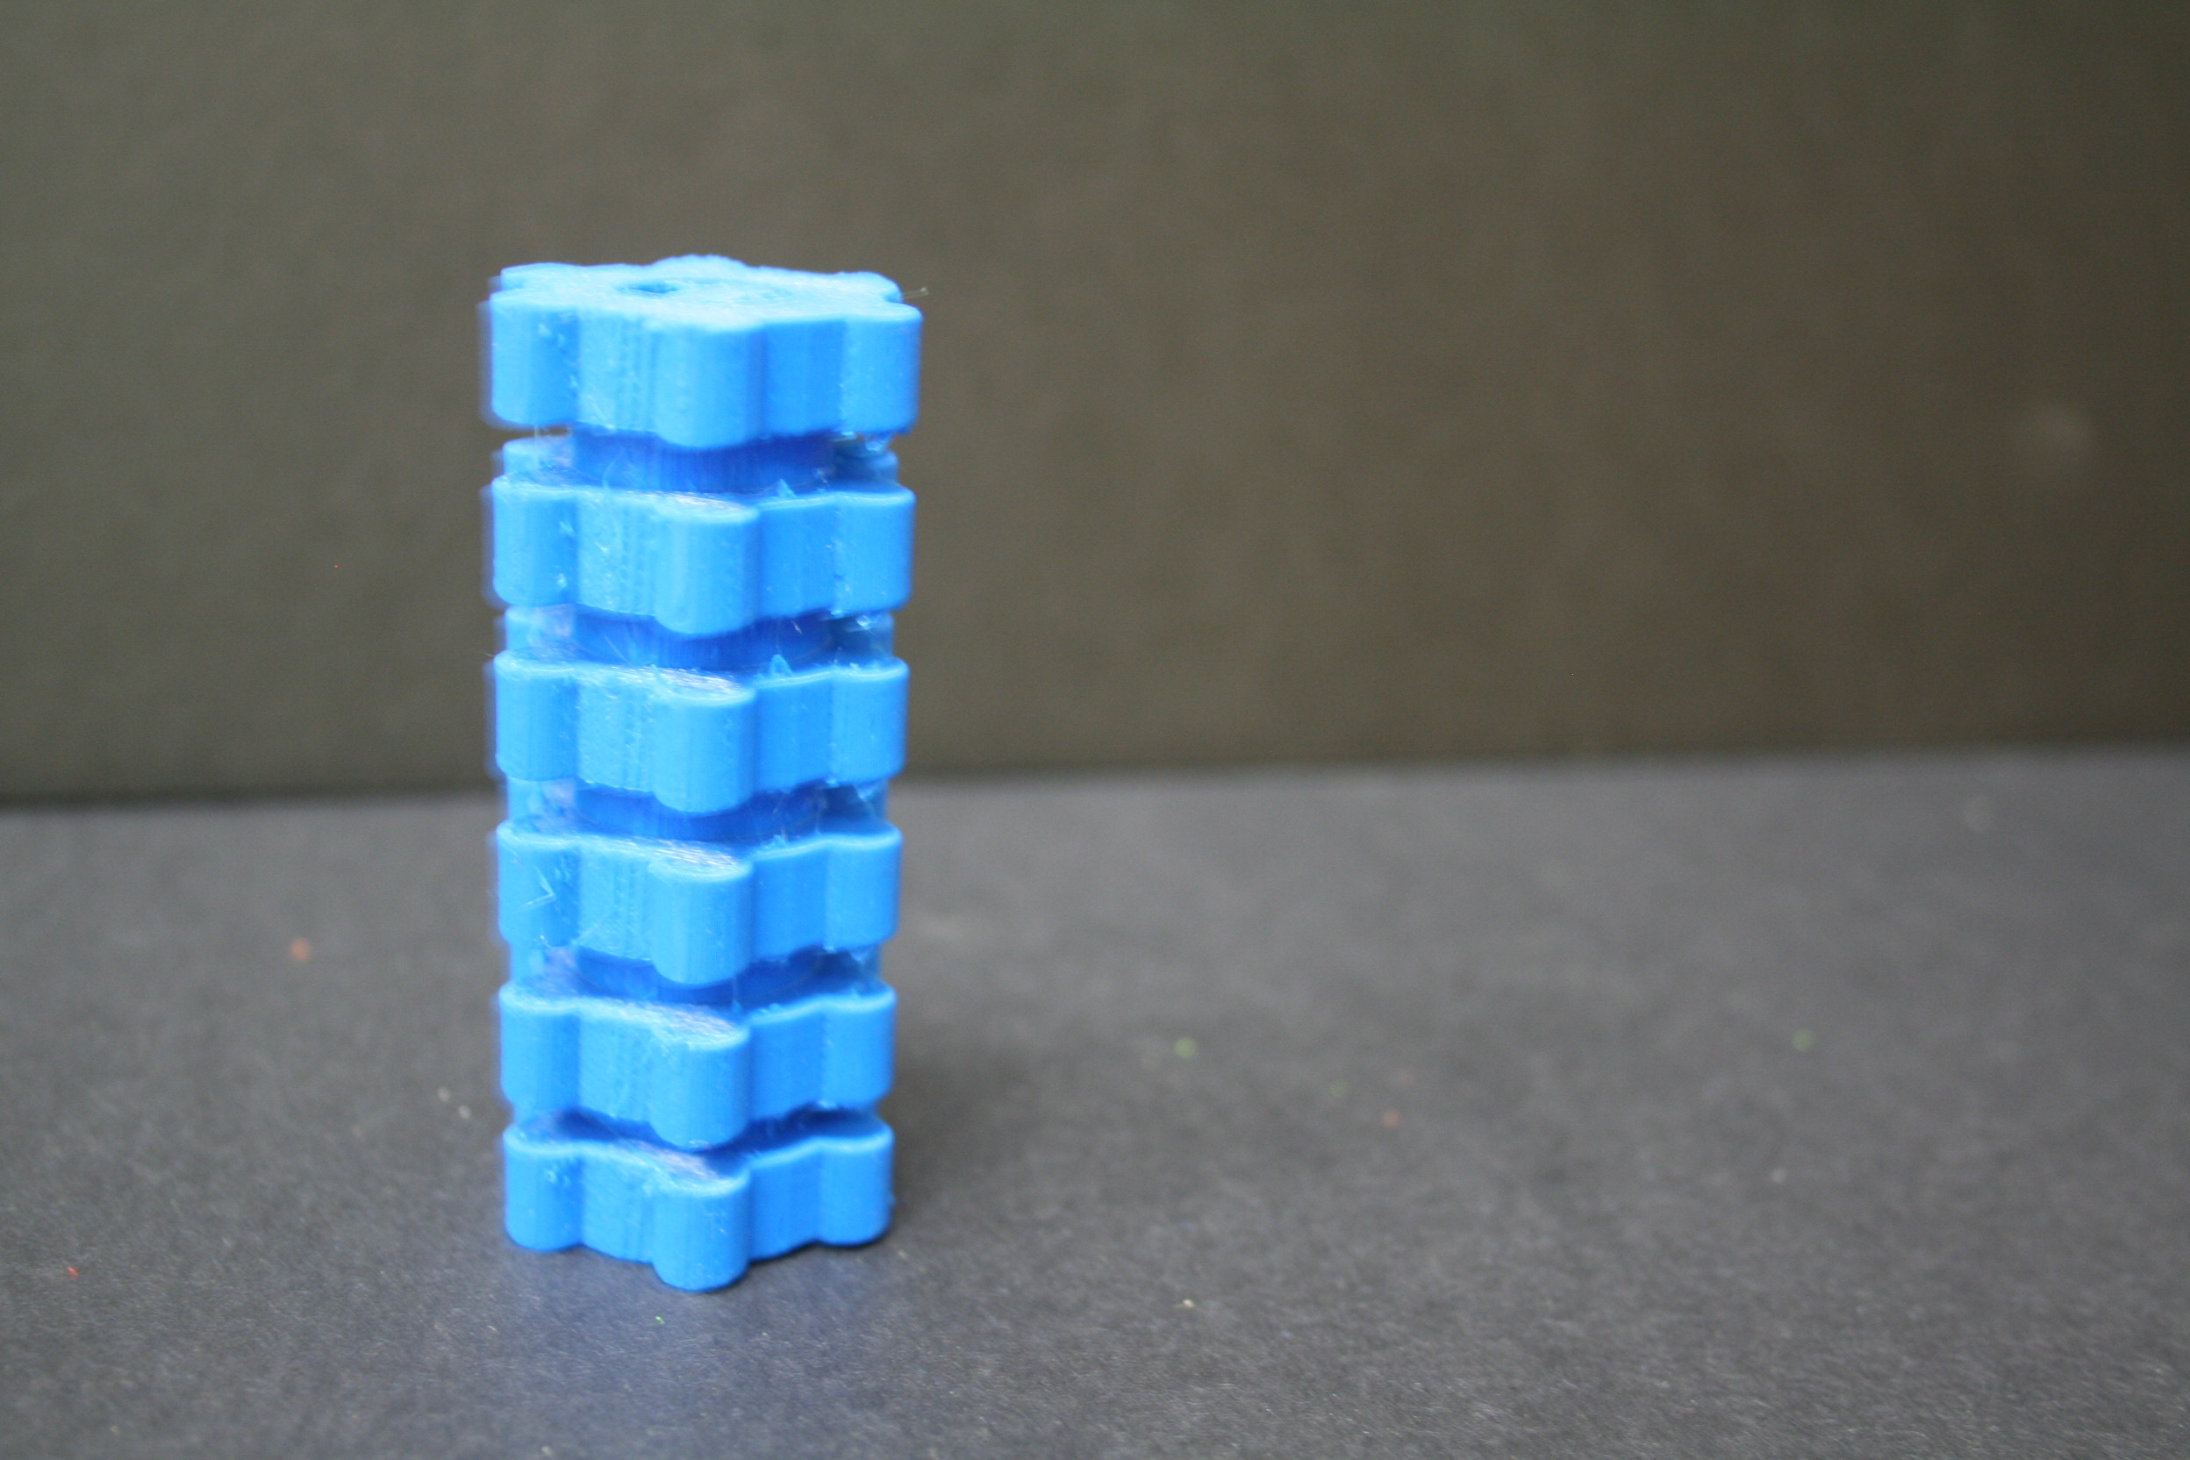
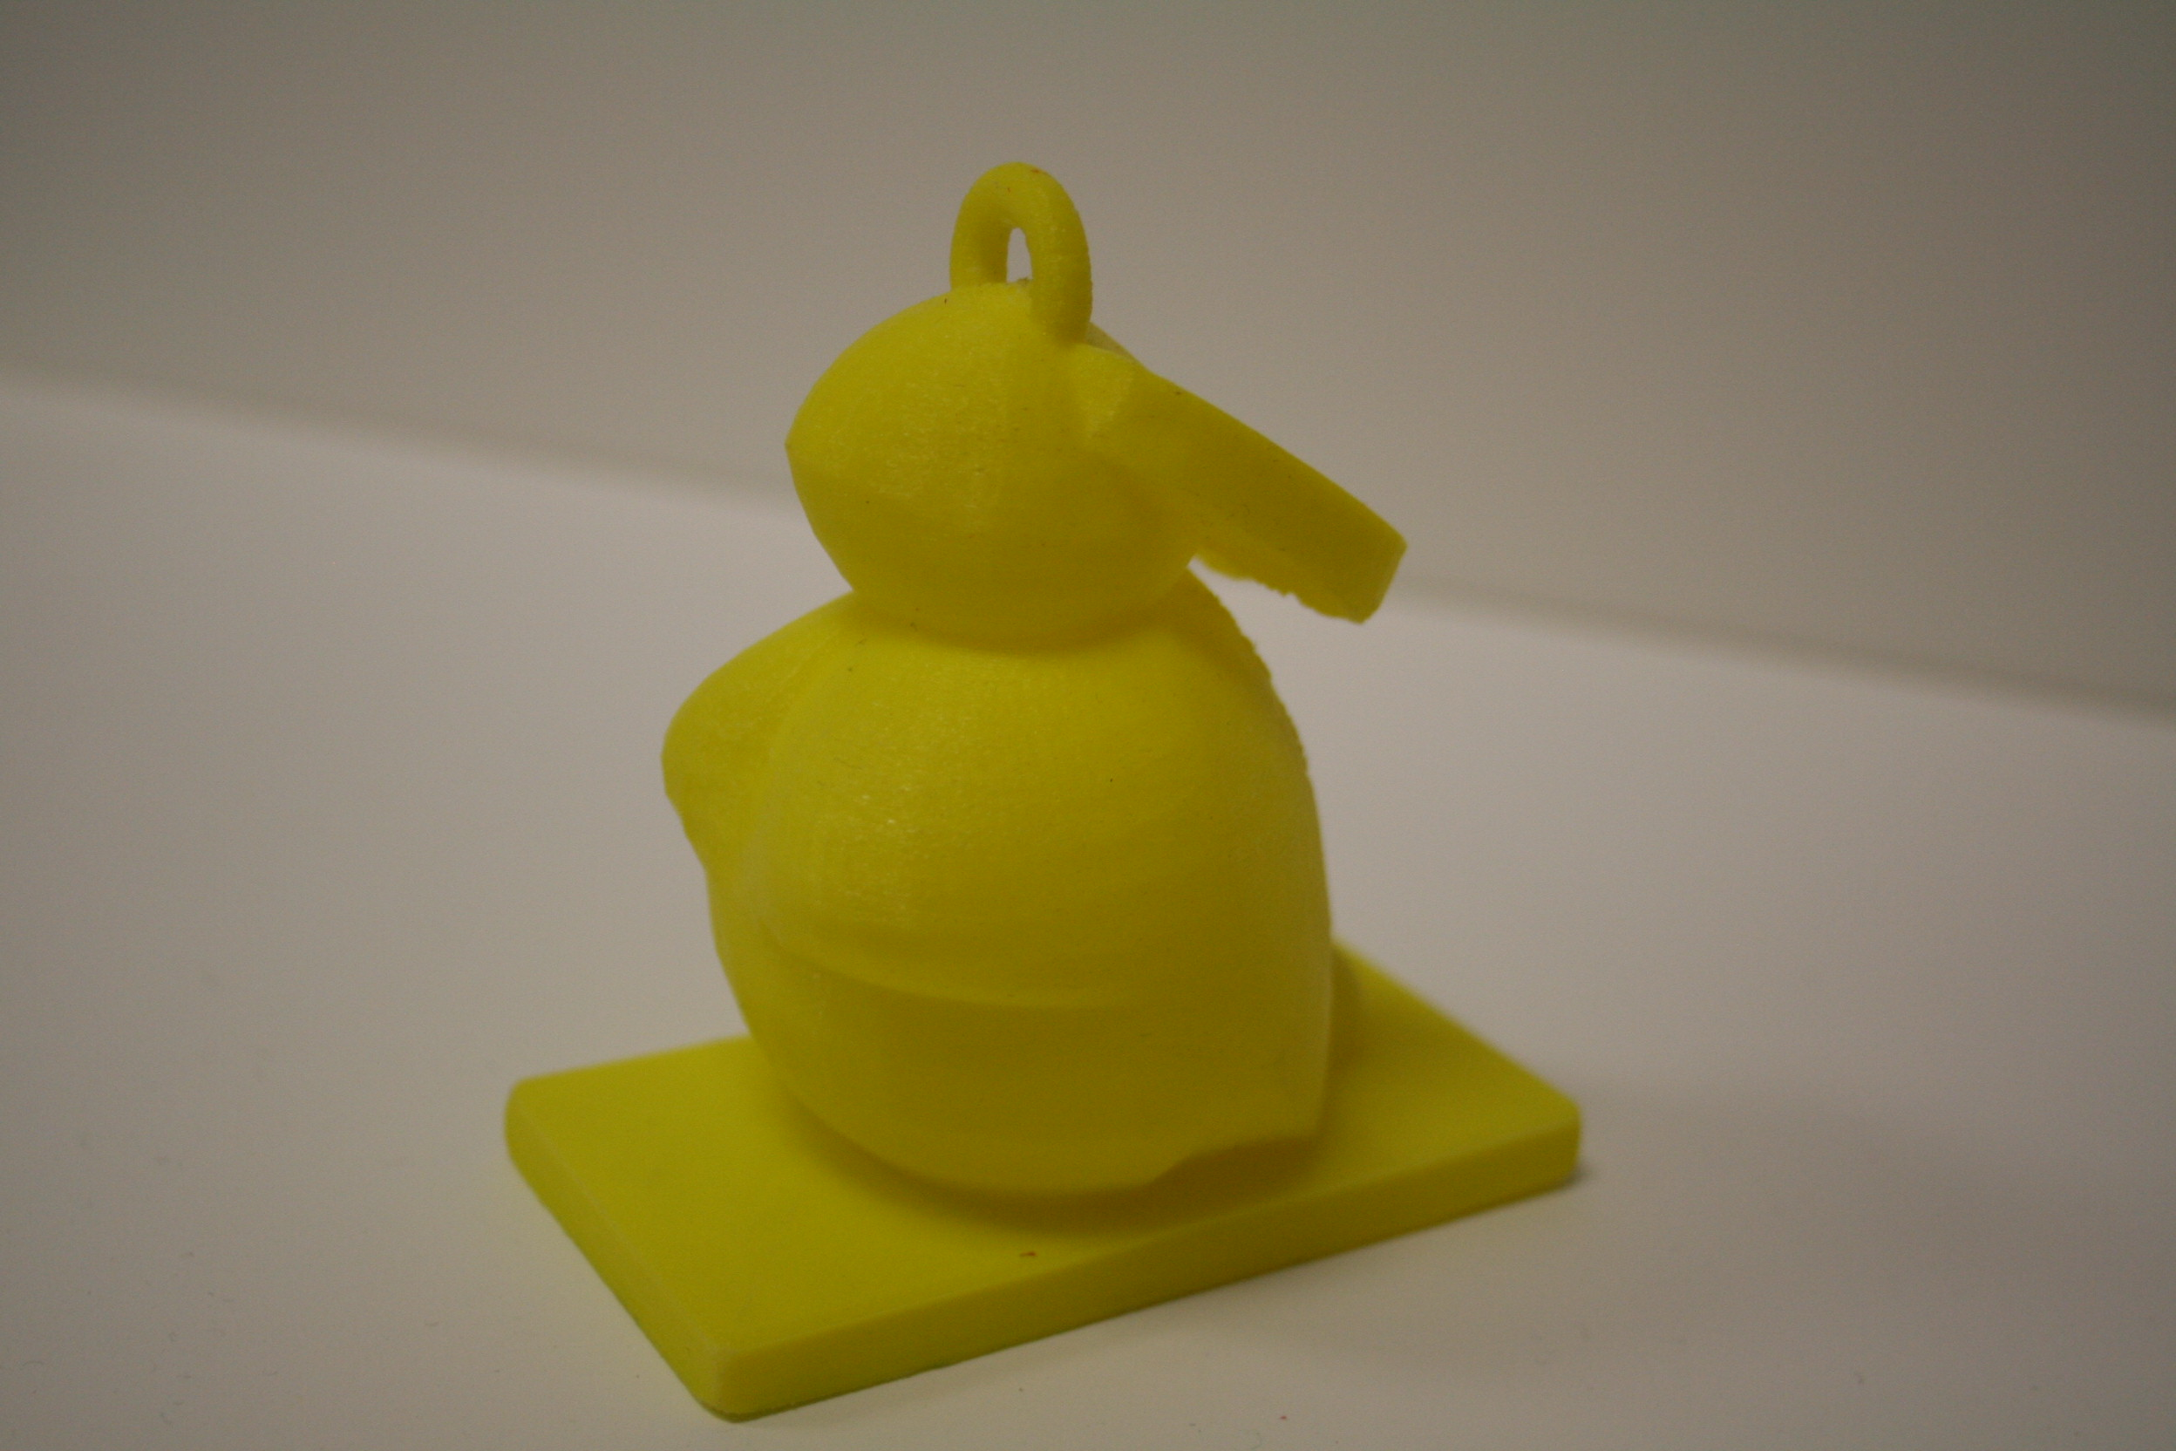

Slide 21
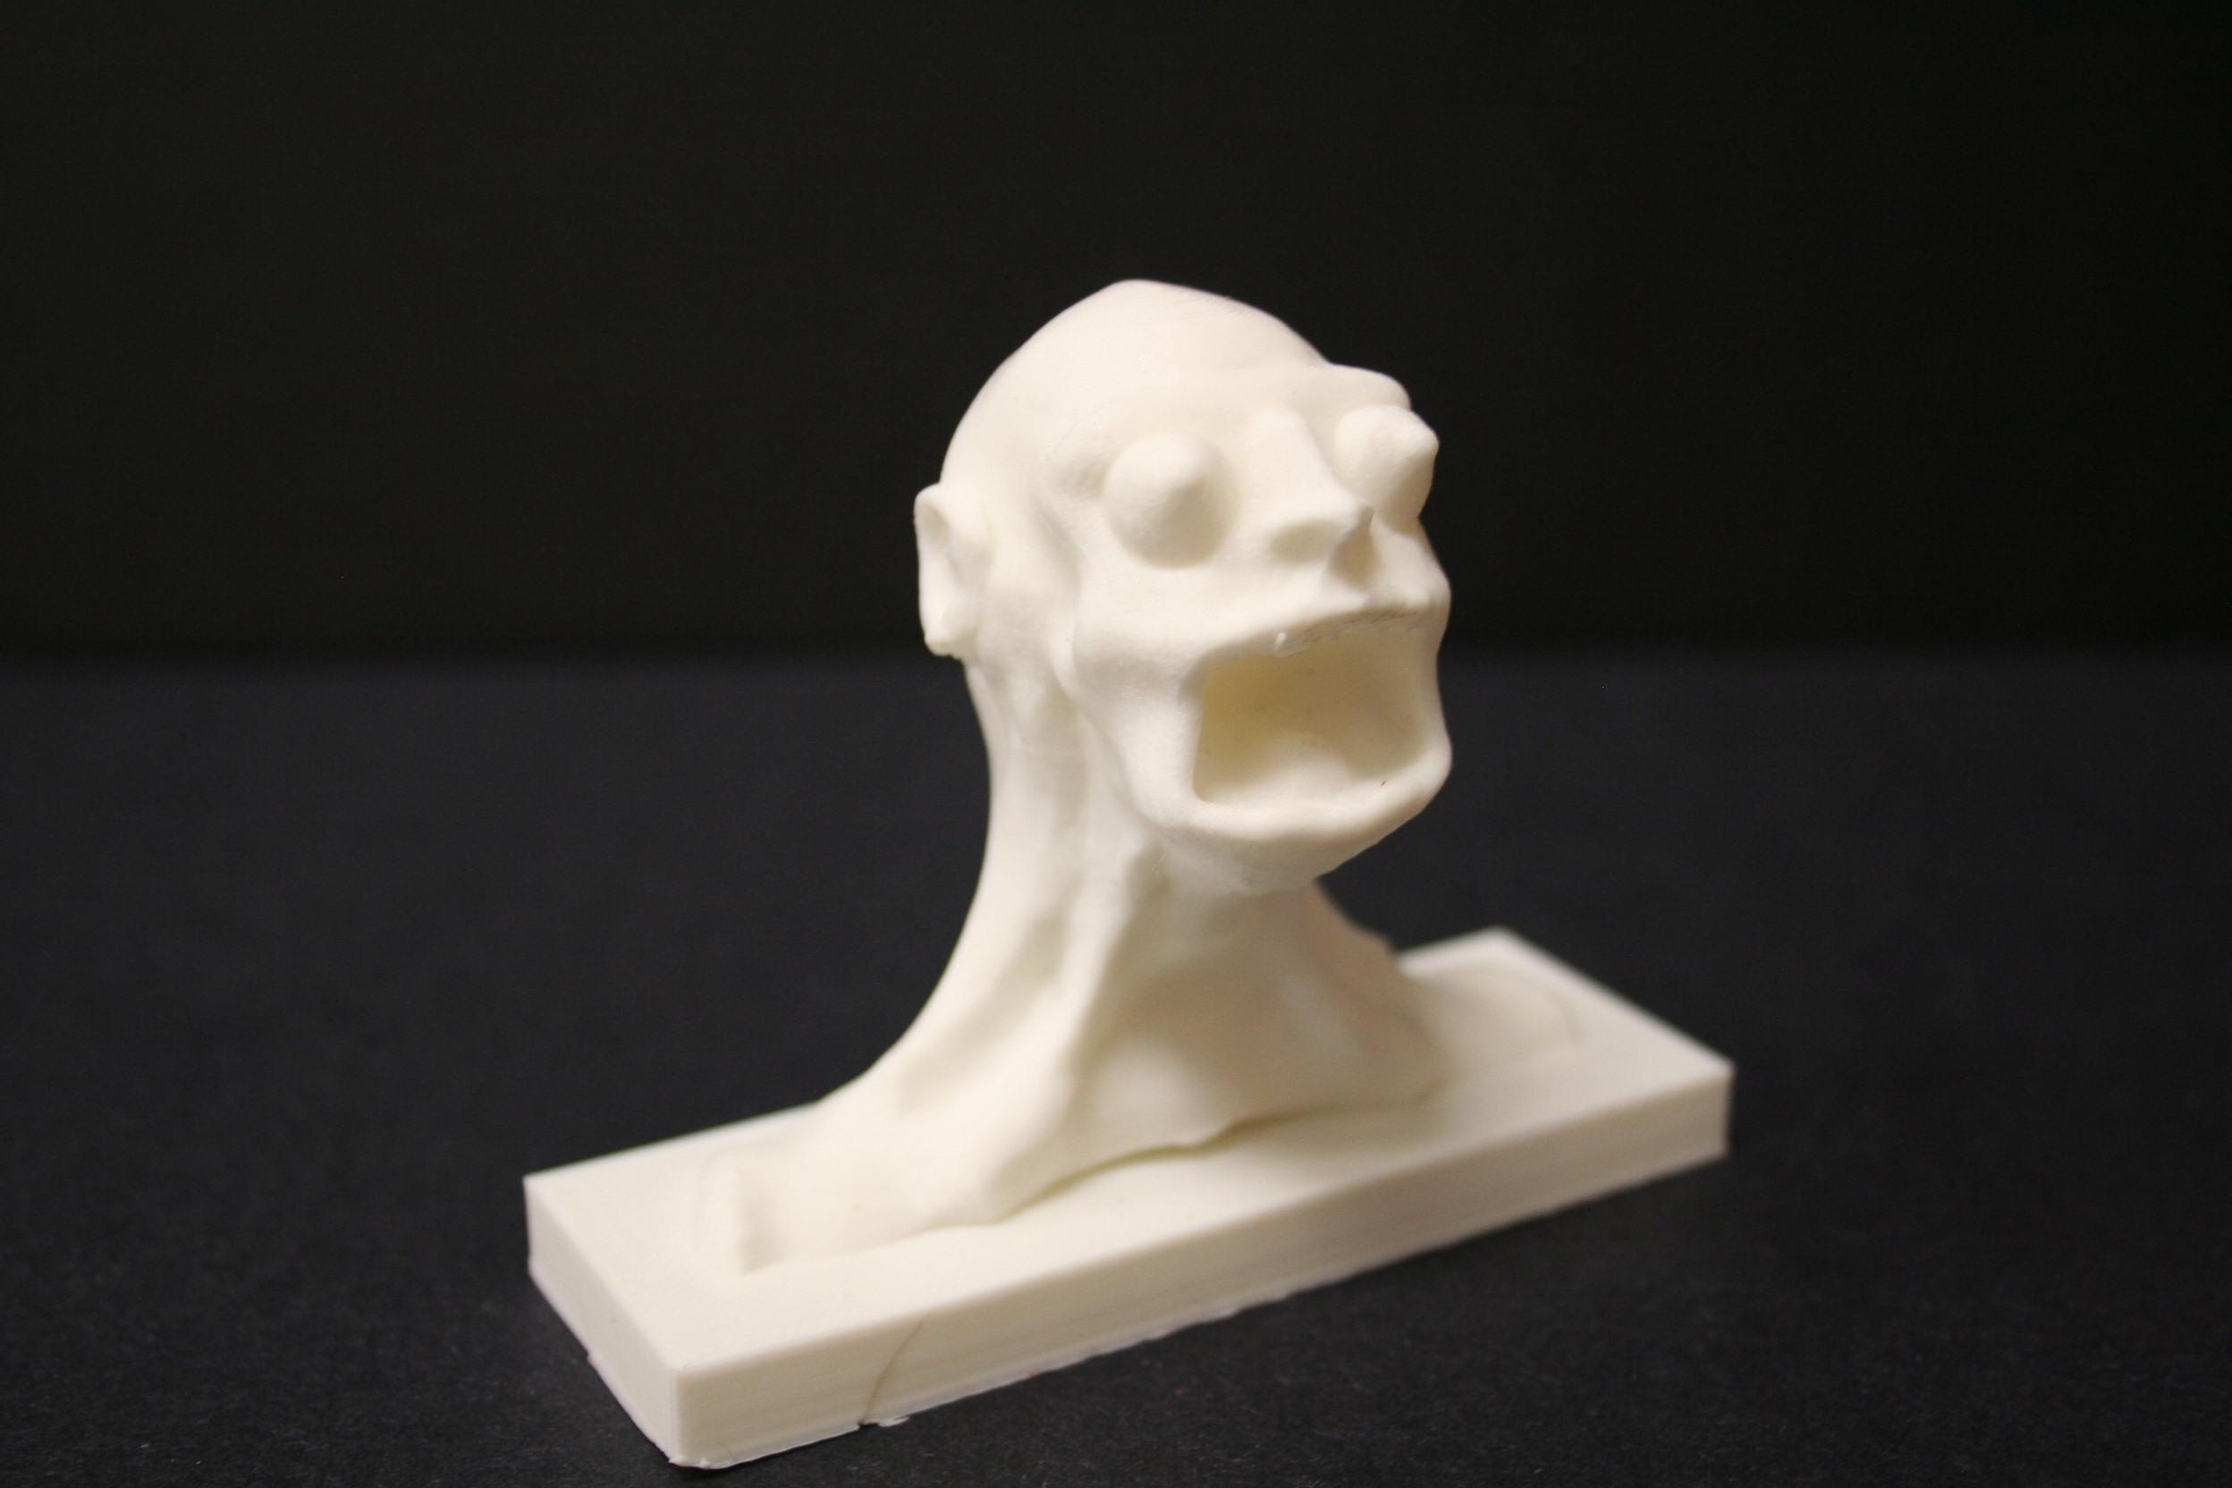
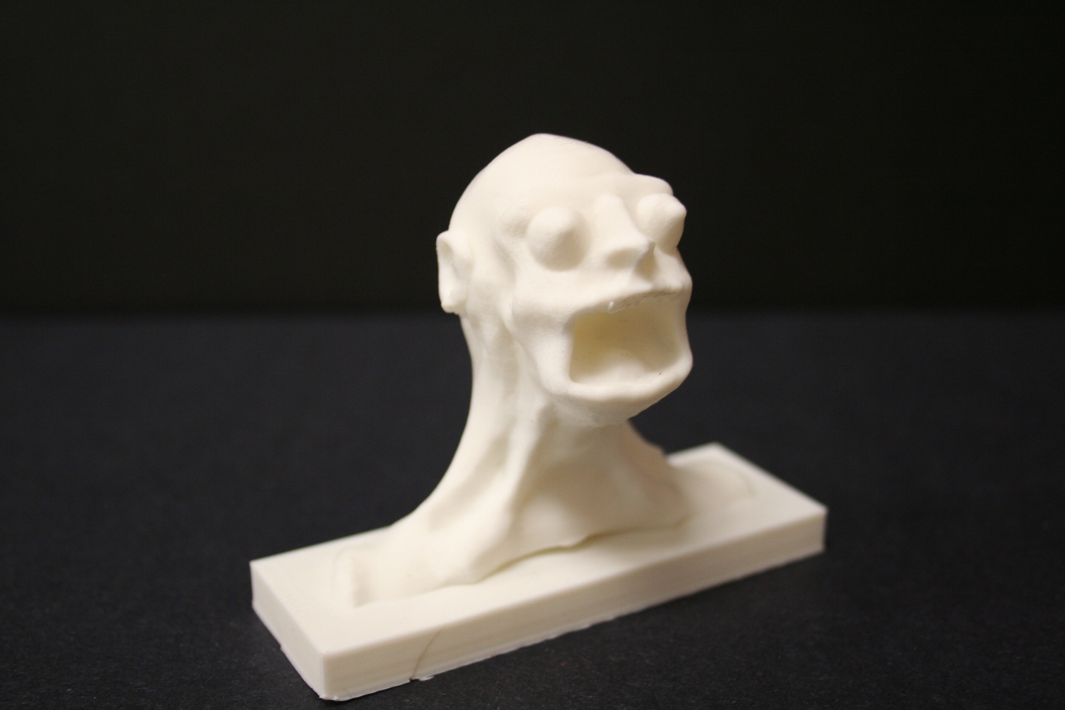
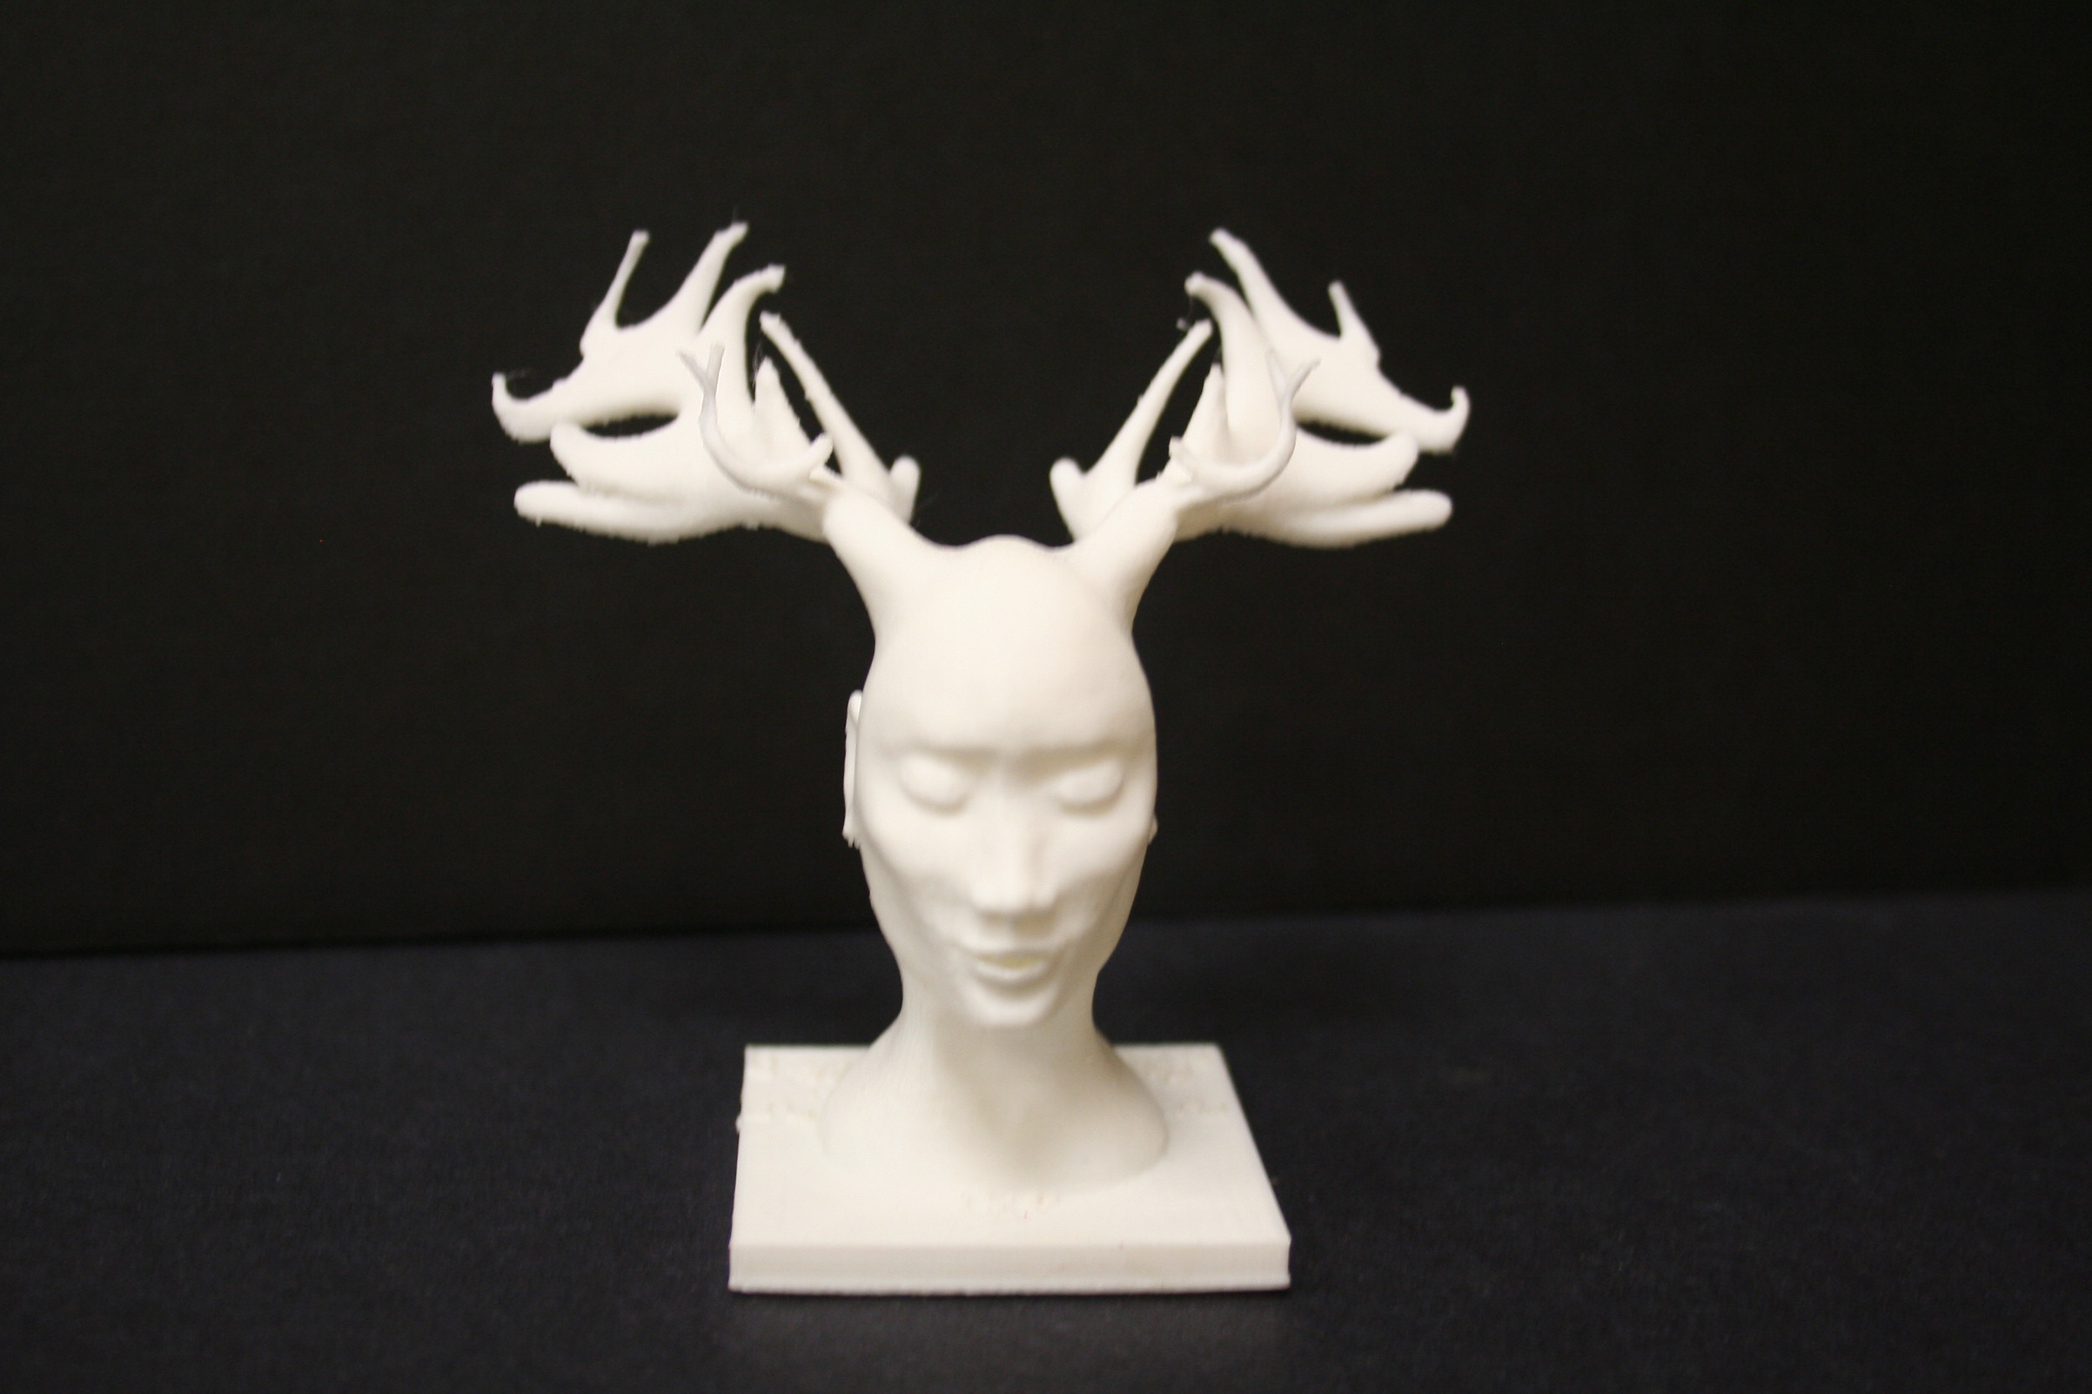
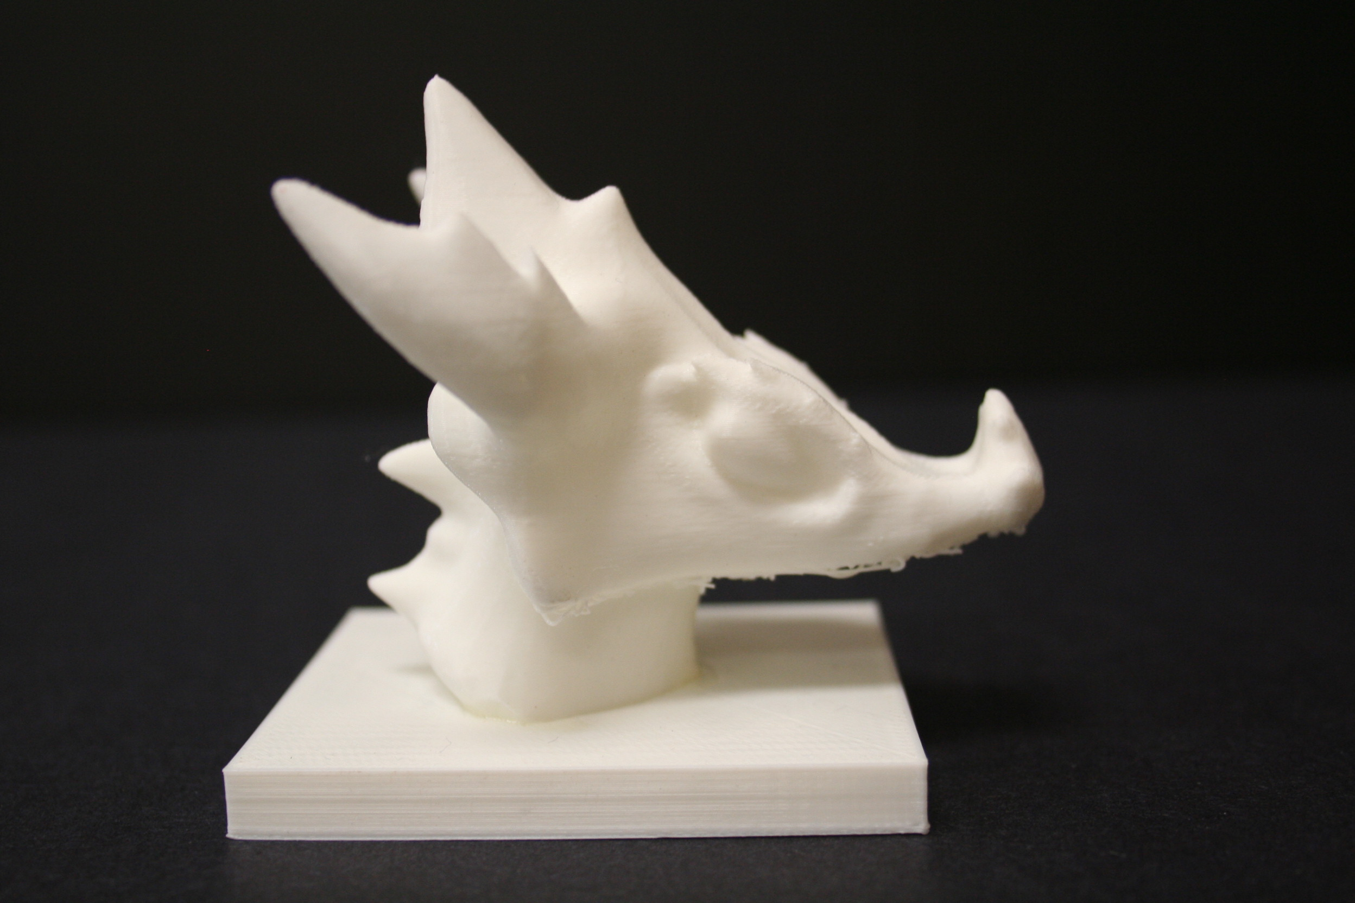

Slide 22
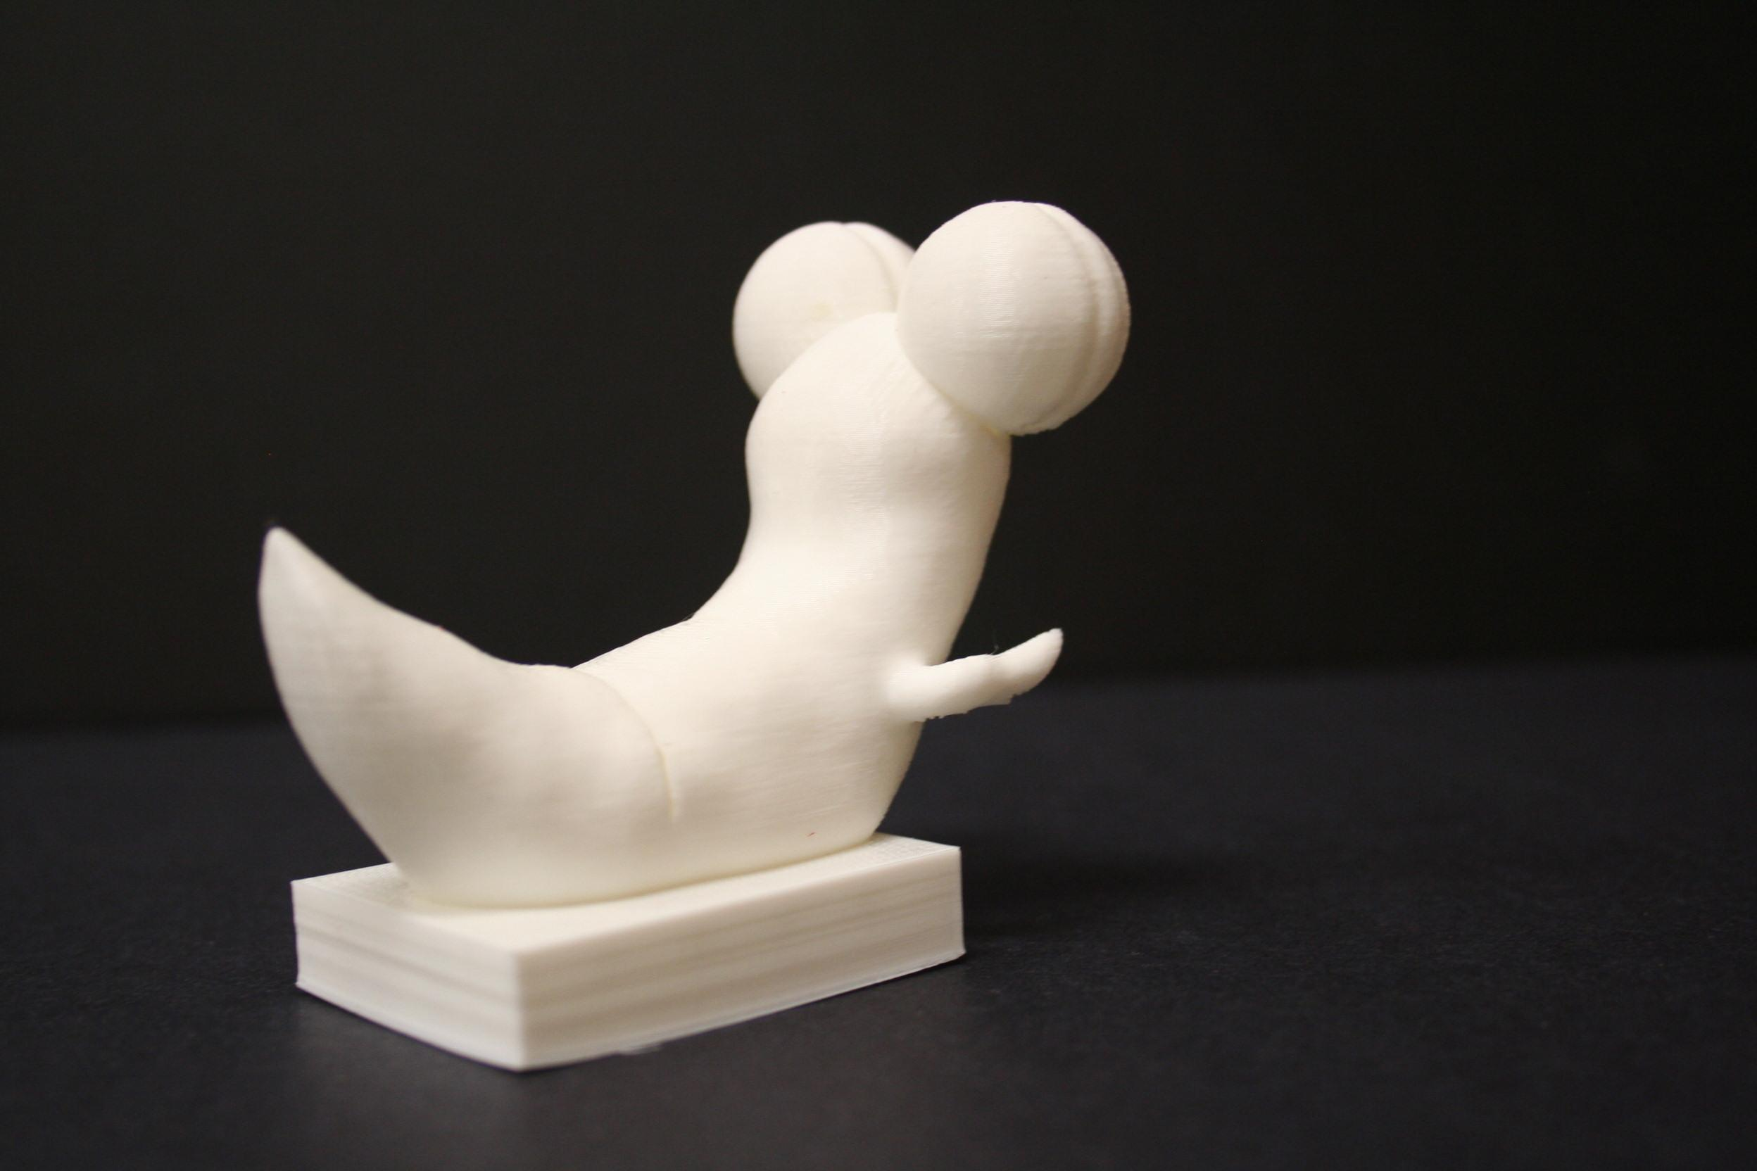
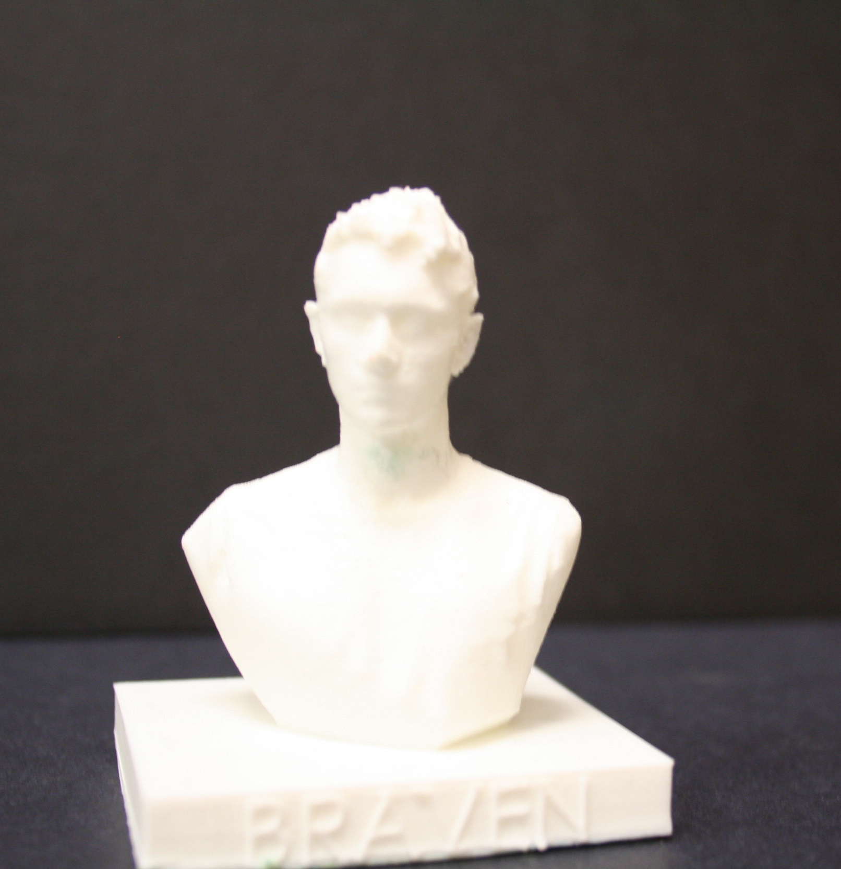
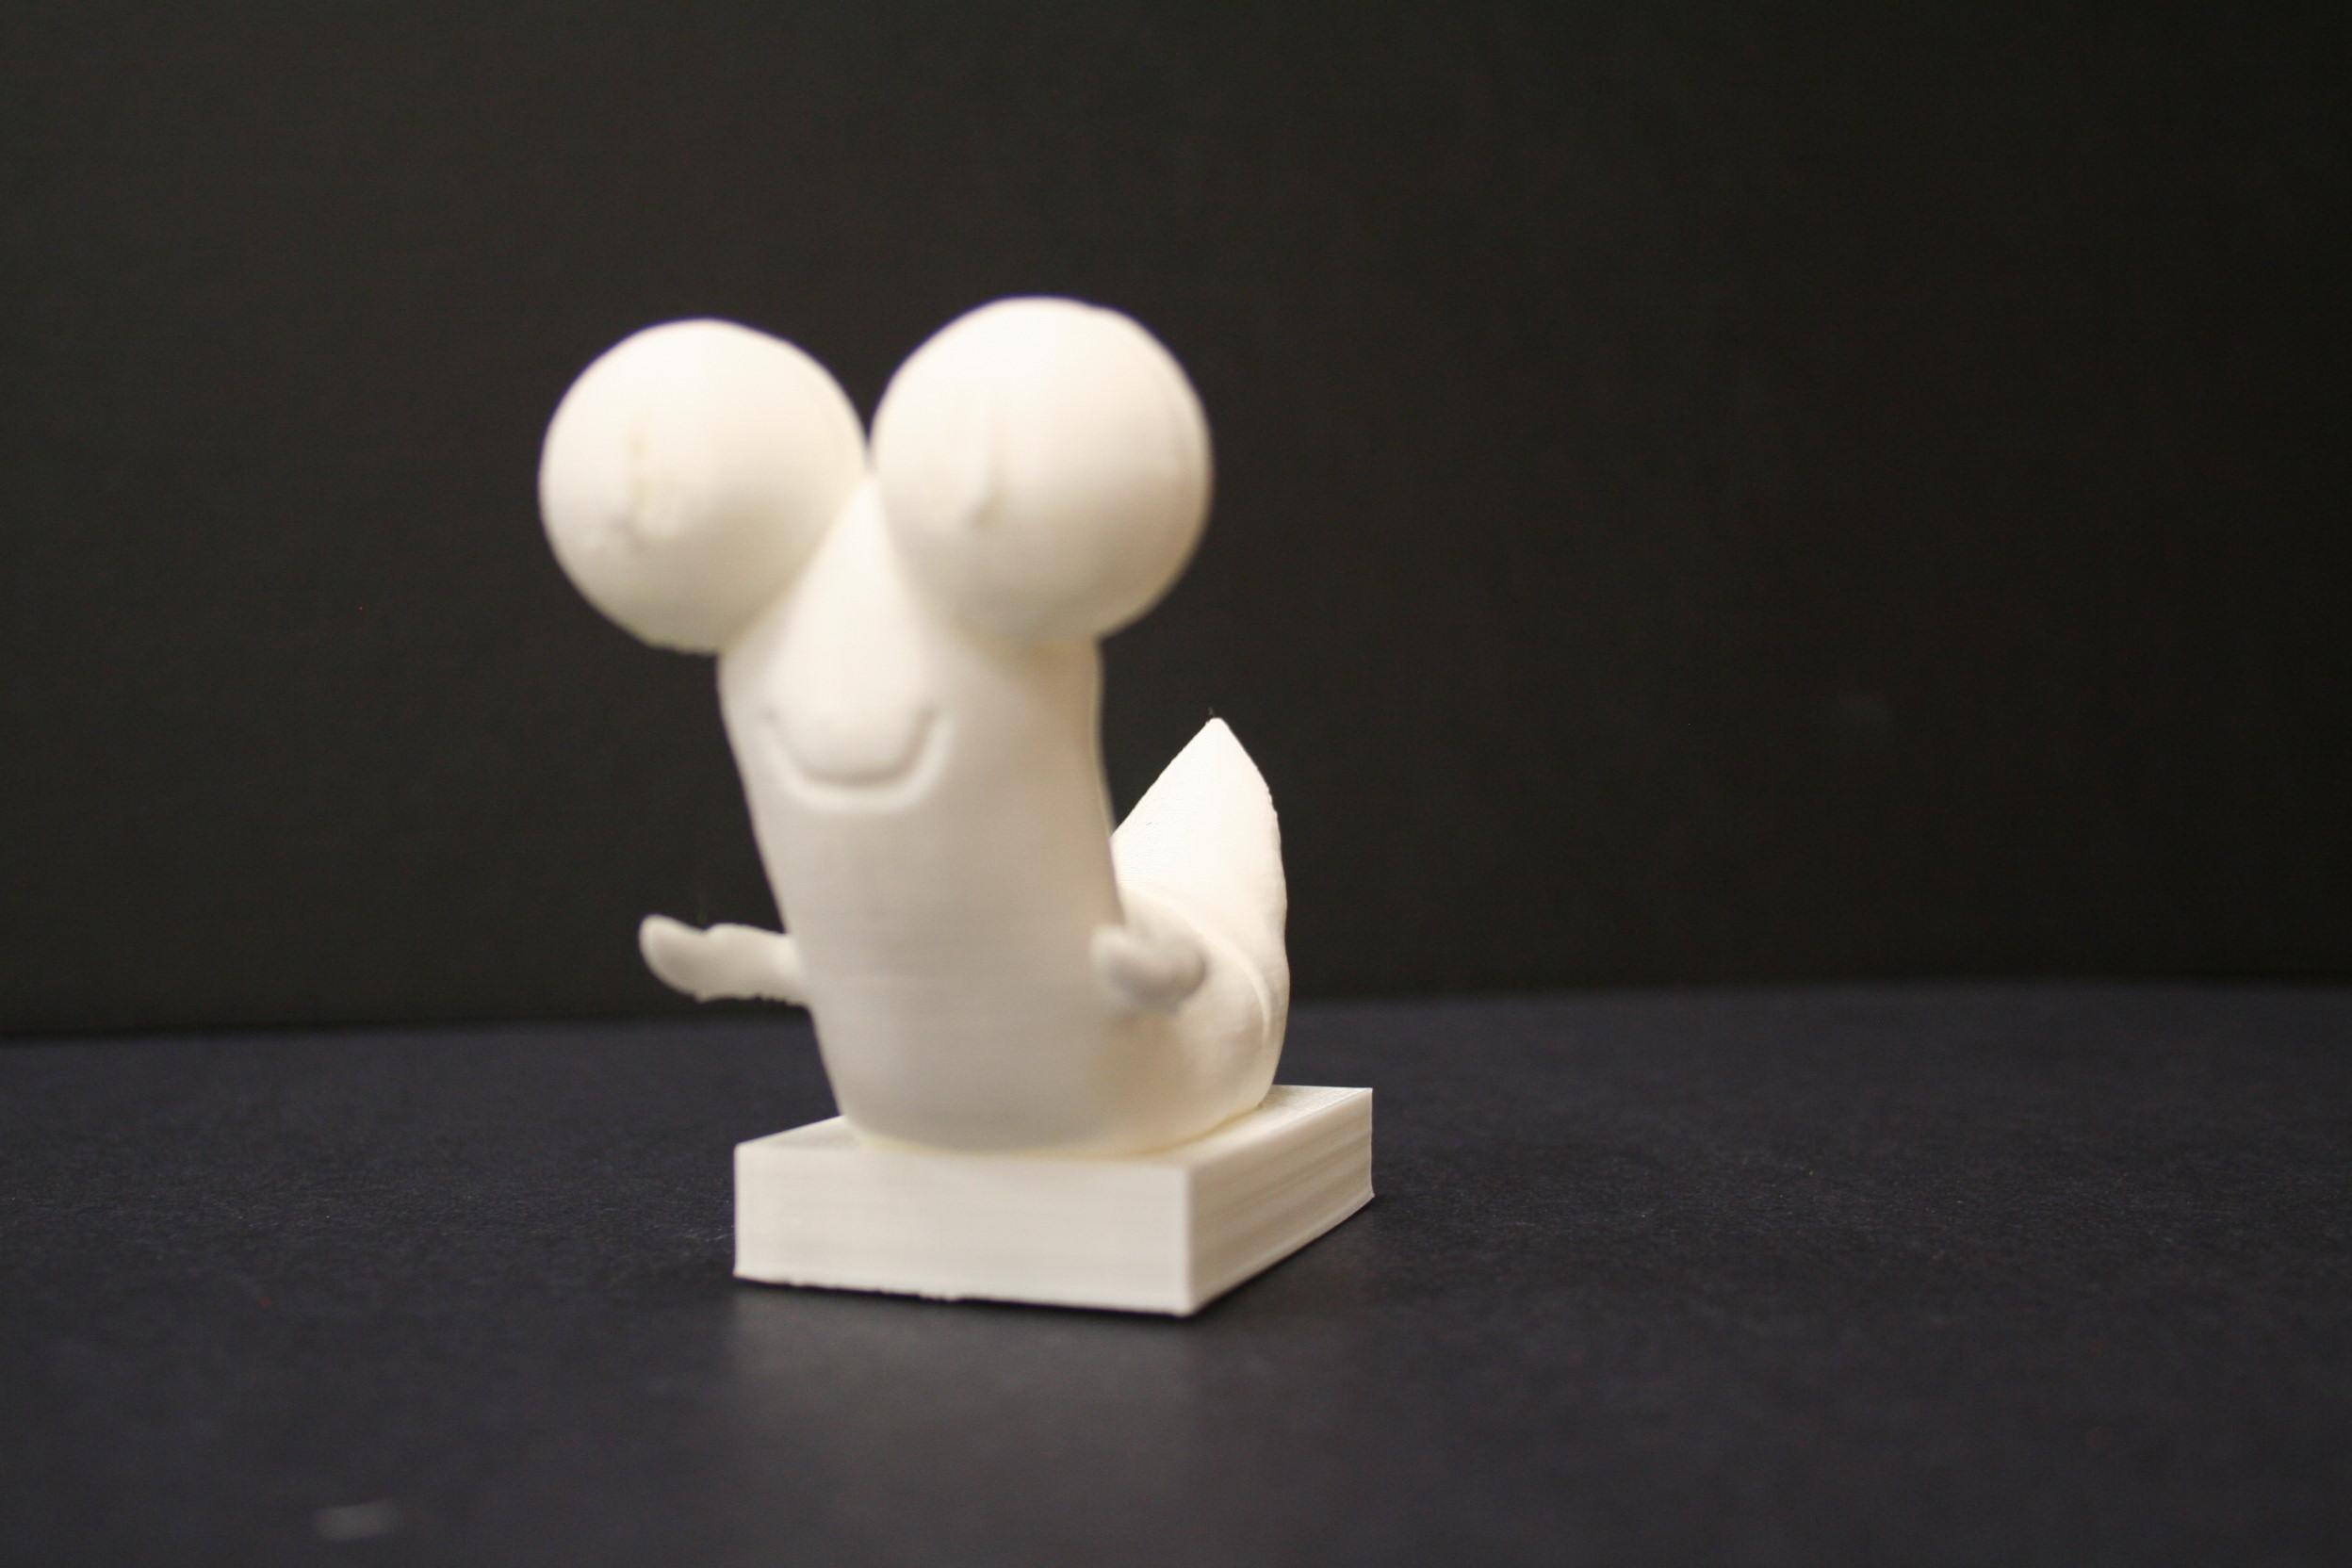

Slide 23
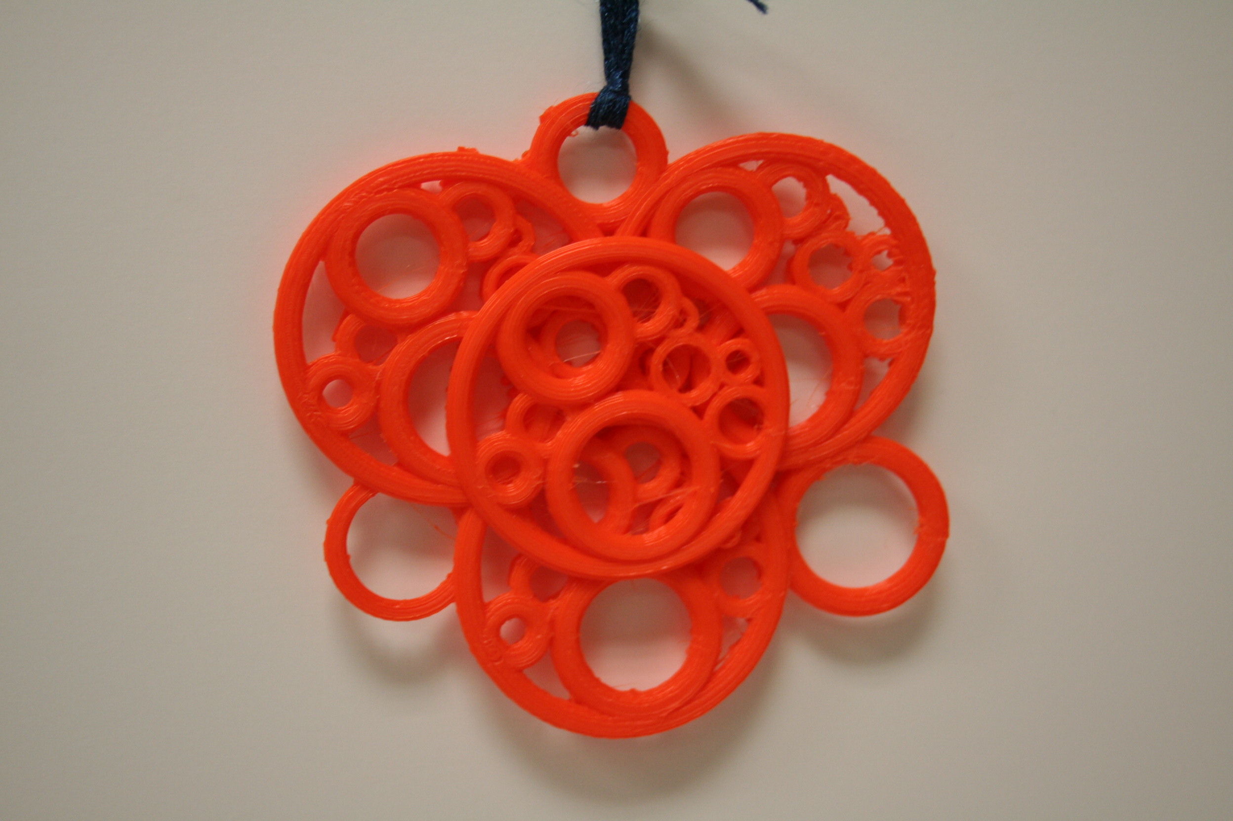
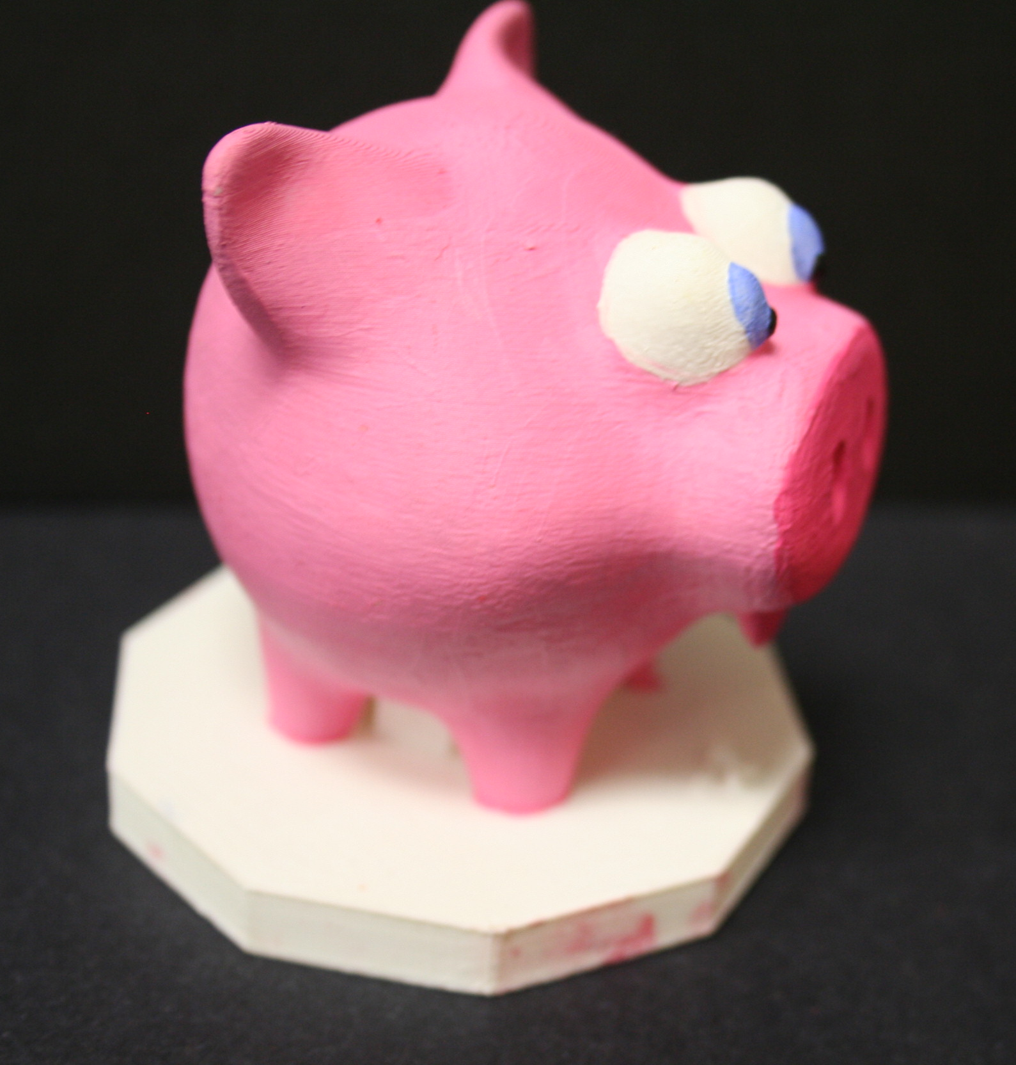
Print Rendering

Slide 24
